Slide 1
Redeemer Lutheran
(1920-2013)
to
Leaven Community Salt and Light Lutheran

Slide 2
Portland, OR Late 1800’s - 1950’s

Slide 3
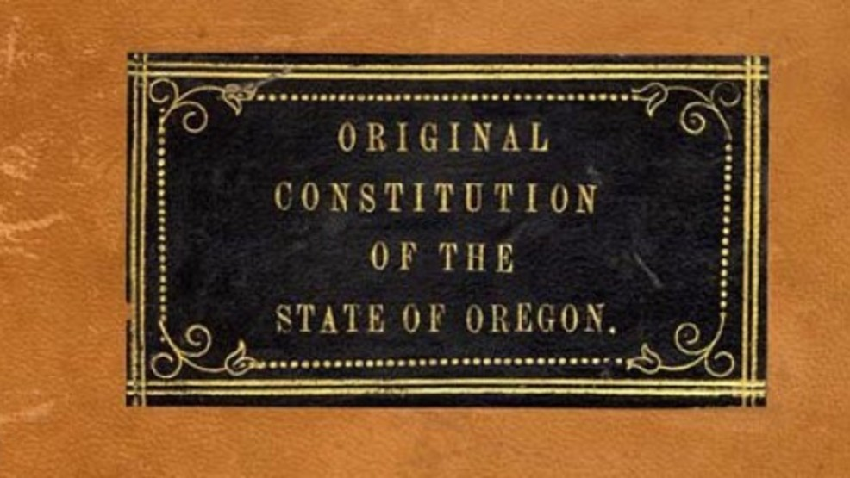
1859-1920
The state’s first constitution, written in 1859, enacted exclusion laws that prohibited blacks from living or owning property within its borders and perpetuated the mentality that Oregon would be explicitly inhabited and governed by whites.

Slide 4
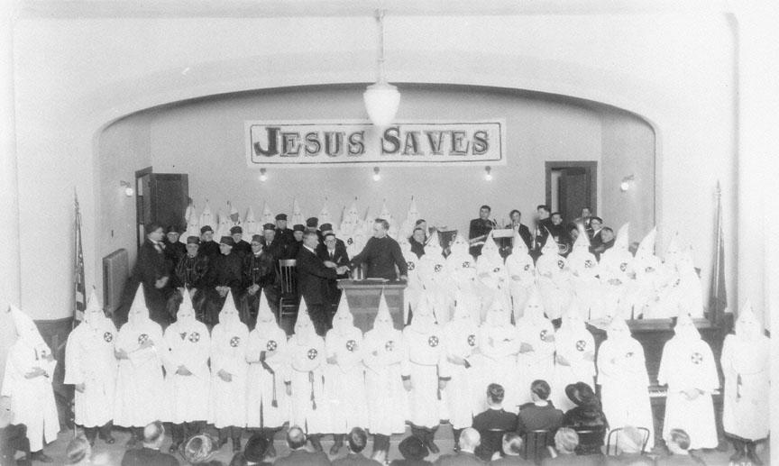
1921-24
Oregon Klu Klux Klan was at its height with membership as high as 200,00. Primary target: Catholics
1922
Election of Ku Klux Klan backed candidates for the offices of Portland Mayor, Chief of Police, County Sheriff, and Governor.

Slide 5
1926
Most prejudiced and anti-black portions of the constitution were officially repealed.

Slide 6
1930
During the Great Depression of the 1930s, African-American waiters, elevator operators, and busboys found themselves squeezed out of jobs to make room for white employees who had refused such positions only years earlier.
As a result, most black men were forced into positions as Pullman porters or janitors, while most black women took posts in domestic housework.

Slide 7
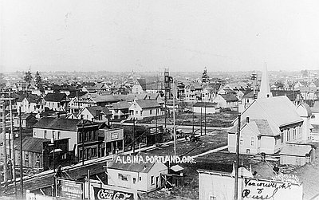
Land Acquisition
1891
Both East Portland and Albina became a part of Portland. European immigrants from Ireland, Germany, Norway, Sweden, Denmark and Finland settled in Albina and Portland, east of the river.

Slide 8
1920-1930’s
Legislation fails prohibiting discrimination in public accommodations.
Vast majority of Portland’s small African-American community lived near Union Station, with many exclusively black-owned businesses thriving along the northwest stretch of Broadway Avenue.
After Broadway Bridge Construction (1911-1913) Some African-Americans moved across the river to NE Portland, bringing their businesses with them. Mt Olivet Baptist Church first black church built at turn of century. Portland Realty Board Code of Ethics prohibits members from selling property in white neighborhoods to African Americans or Asians because they were believed to lower property values.

Slide 9
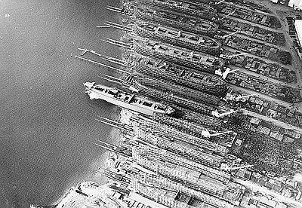
1940’s
The state has a population of fewer than 1,800 African Americans. Then World War II brought thousands of African-Americans to Oregon to work in the shipyards.

Slide 10
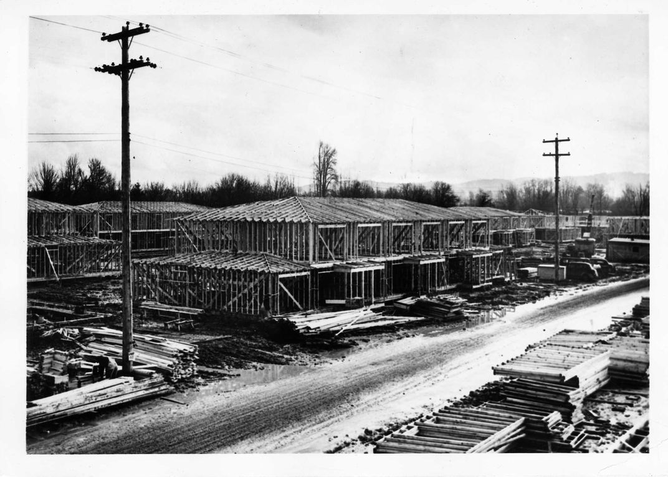
Vanport City
1942-1943
Henry J Kaiser builds Oregon’s 2nd largest city, and the largest public housing unit in the U.S., Vanport city. It houses 40,000 people, 40% of them African-American, who have come to work in the Kaiser Shipyards during WWII.
1946
More than 15,000 African-Americans lived in the Portland area, mostly in Vanport and other segregated housing districts. However in Vanport the hospital, schools, library, nurseries, cafeteria, recreational centers, movie theater and shopping centers are all integrated.

Slide 11
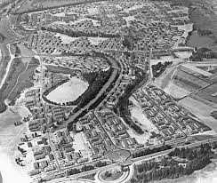
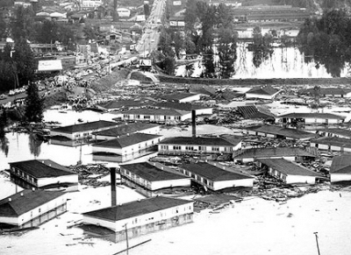
May 30, 1948 Vanport City is destroyed by a flood.

Slide 12
Vanport City
Future Redeemer Lutheran member, Bea Gilmore, her parents, siblings and relatives, fled the floodwaters. They and hundreds of others working families...whites, African-Americans, Japanese, and Native Americans, were washed into Portland.

Slide 13
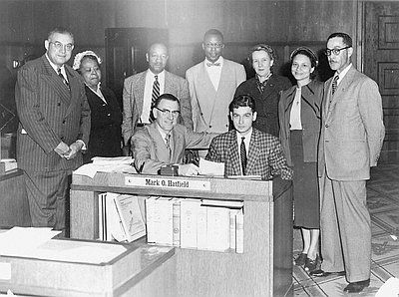
Anti-Discrimination
1950 Portland City Council passed ordinance outlawing discrimination in public accommodations, which was overturned by voters.
1953 The NAACP successfully fought to pass Oregon’s Civil Right Bill making Oregon the twenty-first state in the union to pass legislation outlawing discrimination in public places.

Slide 14
Anti-Discrimination Laws, Codes
1945
Portland branch of the Urban League, founded. Works to provide opportunities in housing, education, and employment for African-Americans facing discrimination in segregated Portland.
1952
Portland Realty Board changed code of ethics.
“It is no longer the board’s official position that the presence of Negroes depresses property values.” However, 90 percent of Realtors would not sell a home to a Negro in a white neighborhood. 1959
Oregon Fair Housing Law prohibits discrimination in all housing.

Slide 15
Land Acquisition
1950’s
Albina experienced significant racial turnover. White residents left en masse for the suburbs.
Black residents moved from temporary war housing into older housing in the Boise and Humboldt neighborhoods, becoming more racially isolated from whites.
Displaced residents relocated in a northeasterly direction, above Fremont Street and toward Northeast 15th Avenue.
The Housing Act of 1957
Cities had the tools they needed to achieve the national goal of clearing “slums” Local officials used them by systematically deeming Black neighborhoods “blighted” and in need of revitalization.

Slide 16
Land Acquisition
Not long after Black Portlanders got settled in Lower Albina, city leaders were making plans to convert the land, which was the heart of their community, into commercial, industrial, and institutional uses.
1956
The Federal Aid Highway Act of 1956 made funds available to cities across the nation to build freeways.

Slide 17
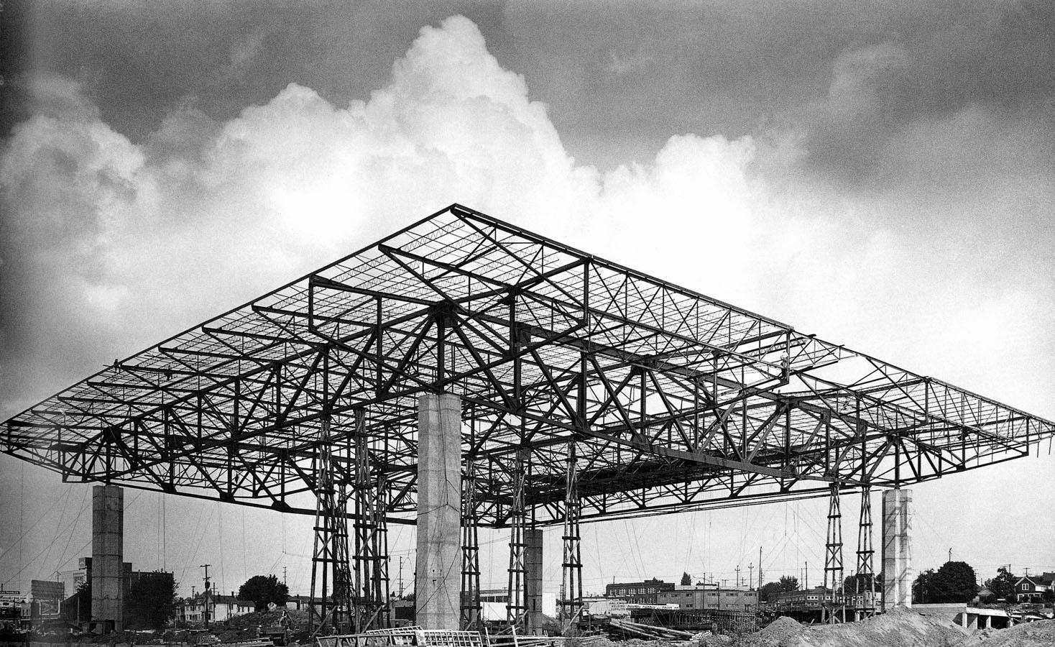
Land Acquisition
1954 $8 million bond approved by voters for Memorial Coliseum.
May, 1956
Portland voters restricted construction of the Veterans Memorial Coliseum to the eastside by a margin of 303 votes.

Slide 18
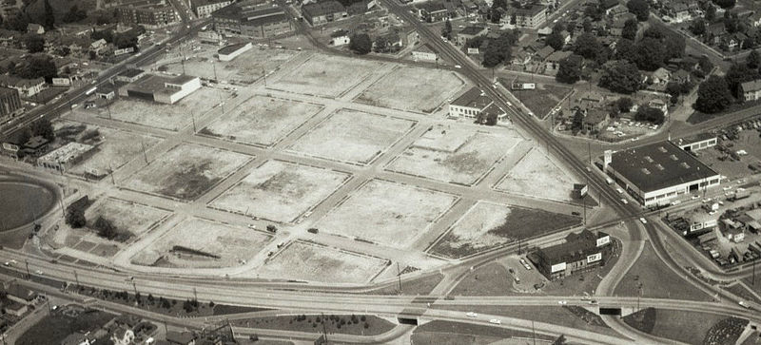
Land Acquisition
Construction begins on the Memorial Coliseum in the Eliot neighborhood, destroying commercial establishments and 476 homes, roughly half of them inhabited by African Americans.

Slide 19
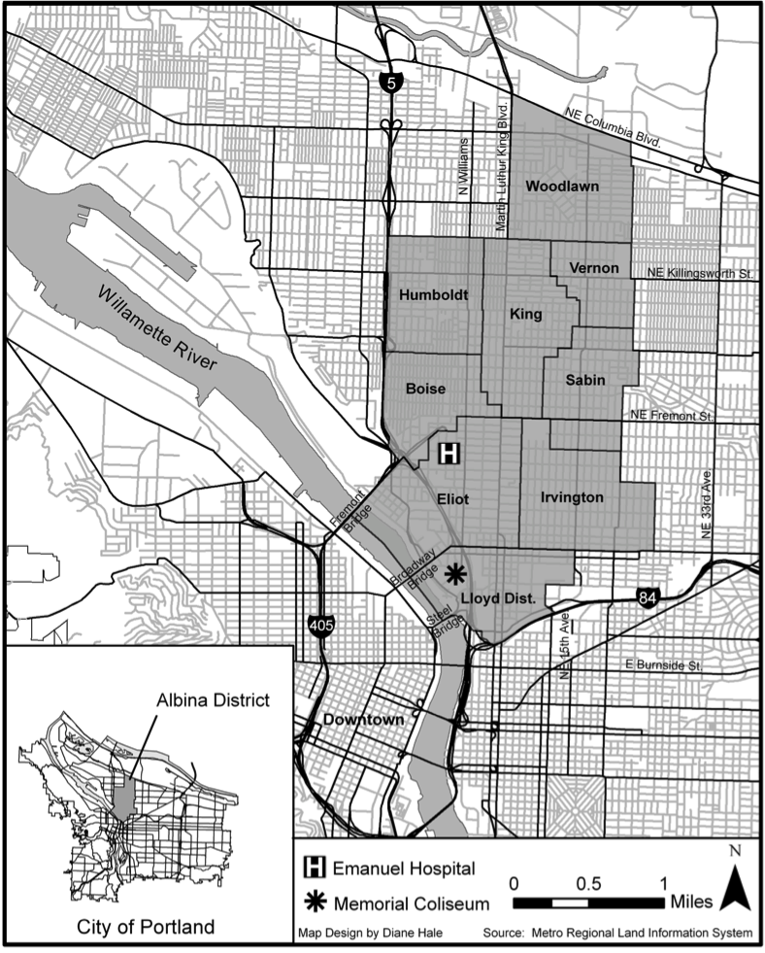
1950’s
1959
By decade’s end, there were 23,000 fewer White and 7,300 more Black residents in Albina (total population was 31,510).
Lower Albina grew from 1/5th to ½ Black, and
Upper Albina increased from less than 1/20th to nearly 1/3 Black.
*

Slide 20
Redeemer Lutheran 1920’s – 1950’s

Slide 21
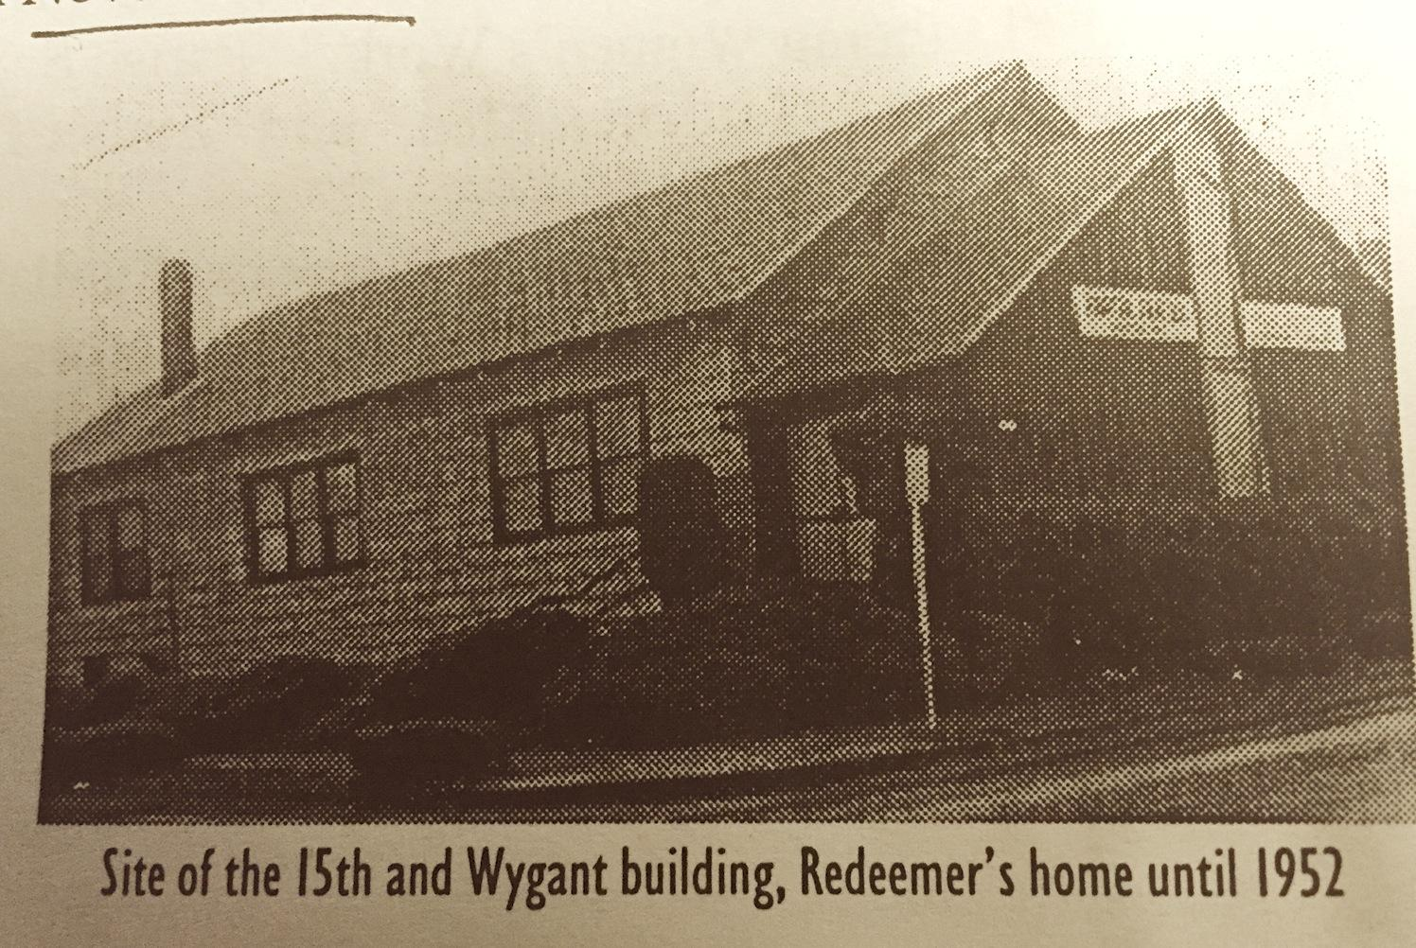
Redeemer Lutheran Land Acquisition
March 17, 1920 The Evangelical Lutheran Church of the Redeemer incorporated and congregation met in building on NE 15th & Wygant. Land purchased for $2,800 by a member on condition congregation support him on the project.
June 7, 1942
Mortgage-burning ceremony

Slide 22
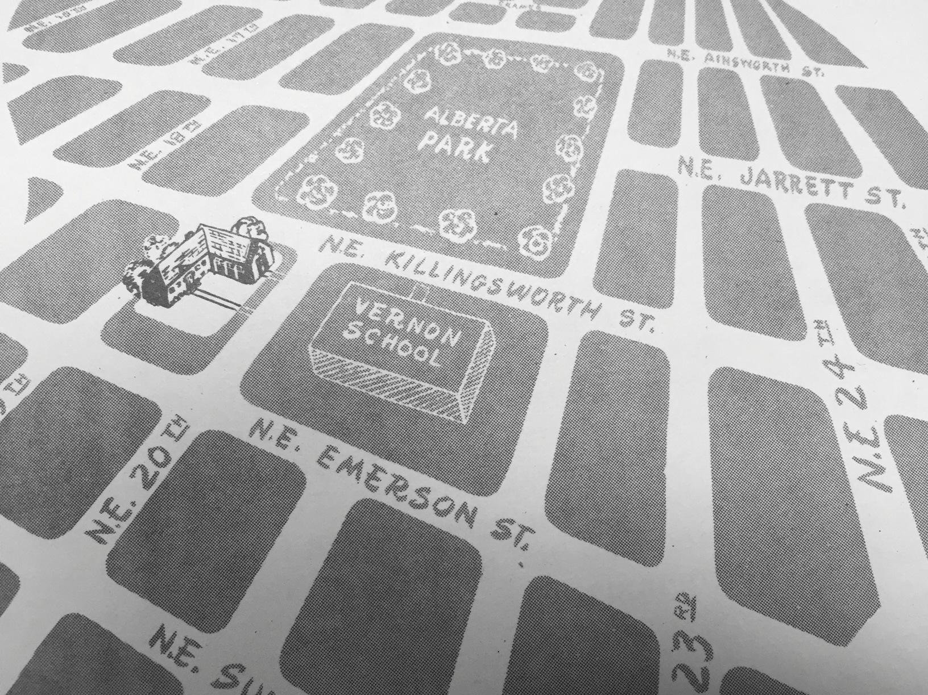
1940’s - 1950’s
Land and Buildings
Redeemer Lutheran Land Acquisition
November 1943
Land on 20th and Killingsworth purchased for $1000

Slide 23
1940’s - 1950’s
Land and Buildings
Land Acquisition
February 24, 1952
Cornerstone laid
June 1, 1952
Building dedicated. Building valued at $70,000.

Slide 24
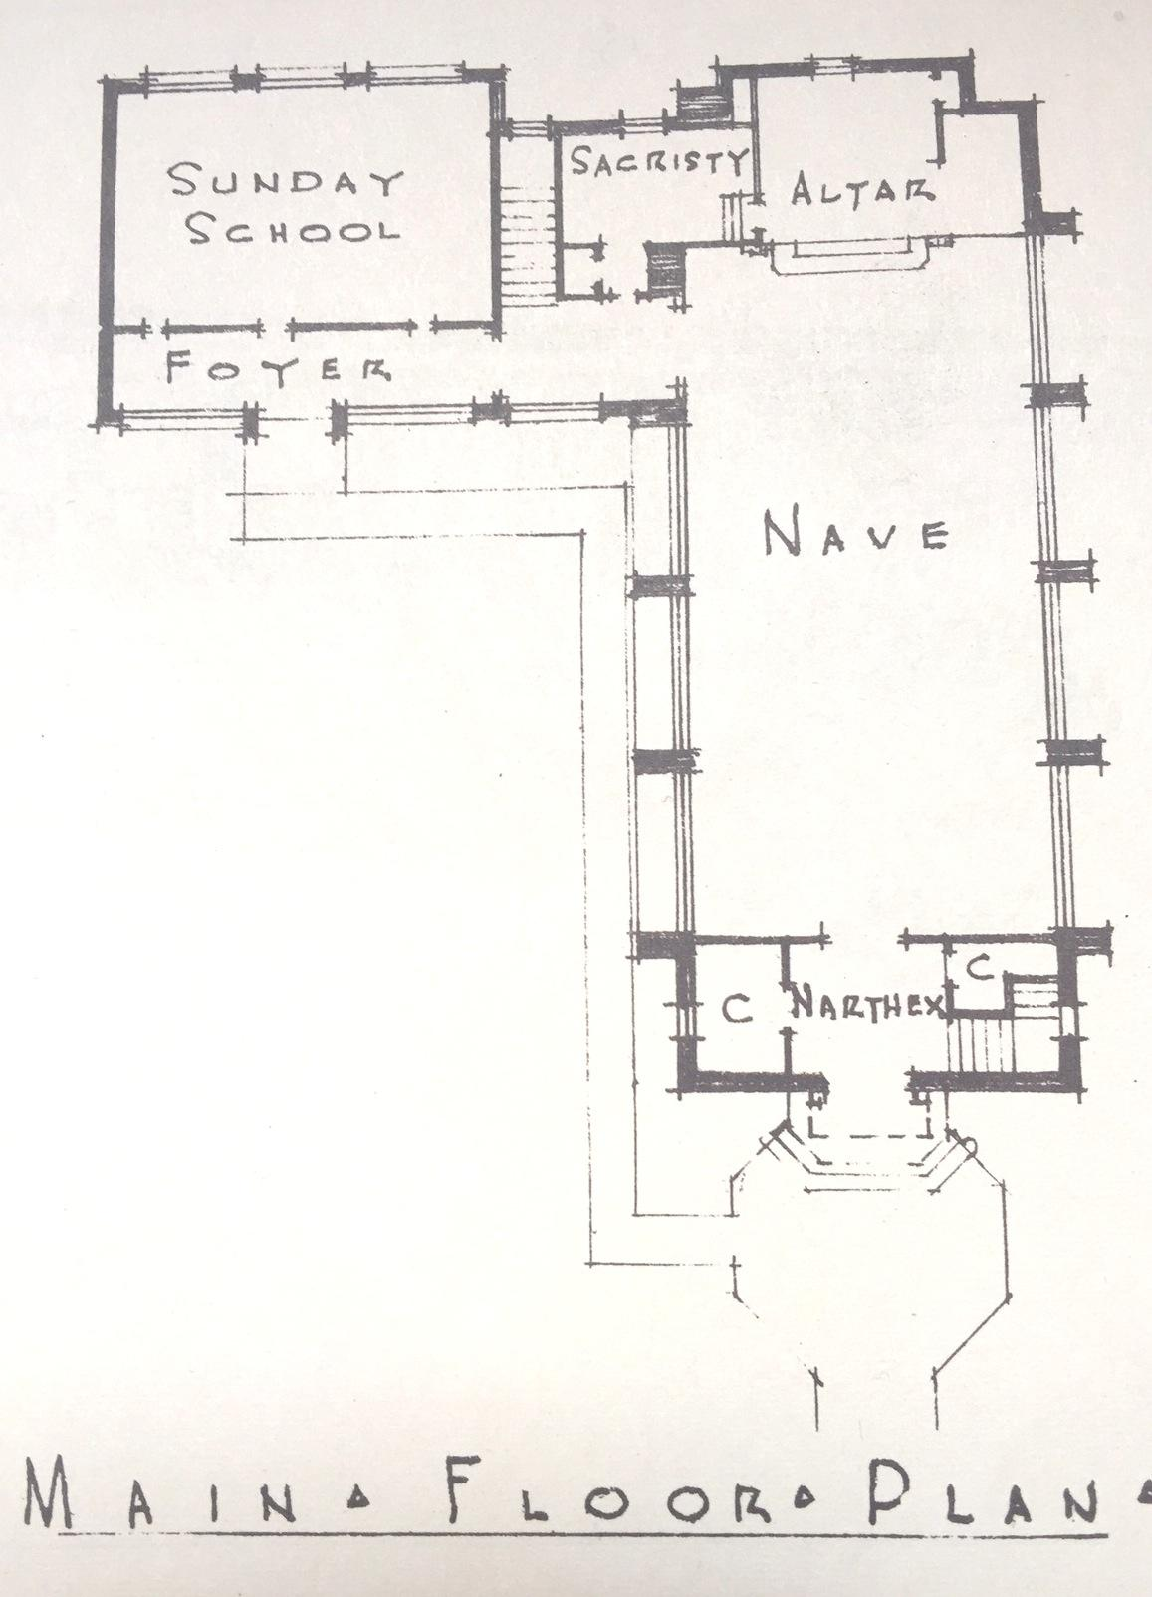

Slide 25
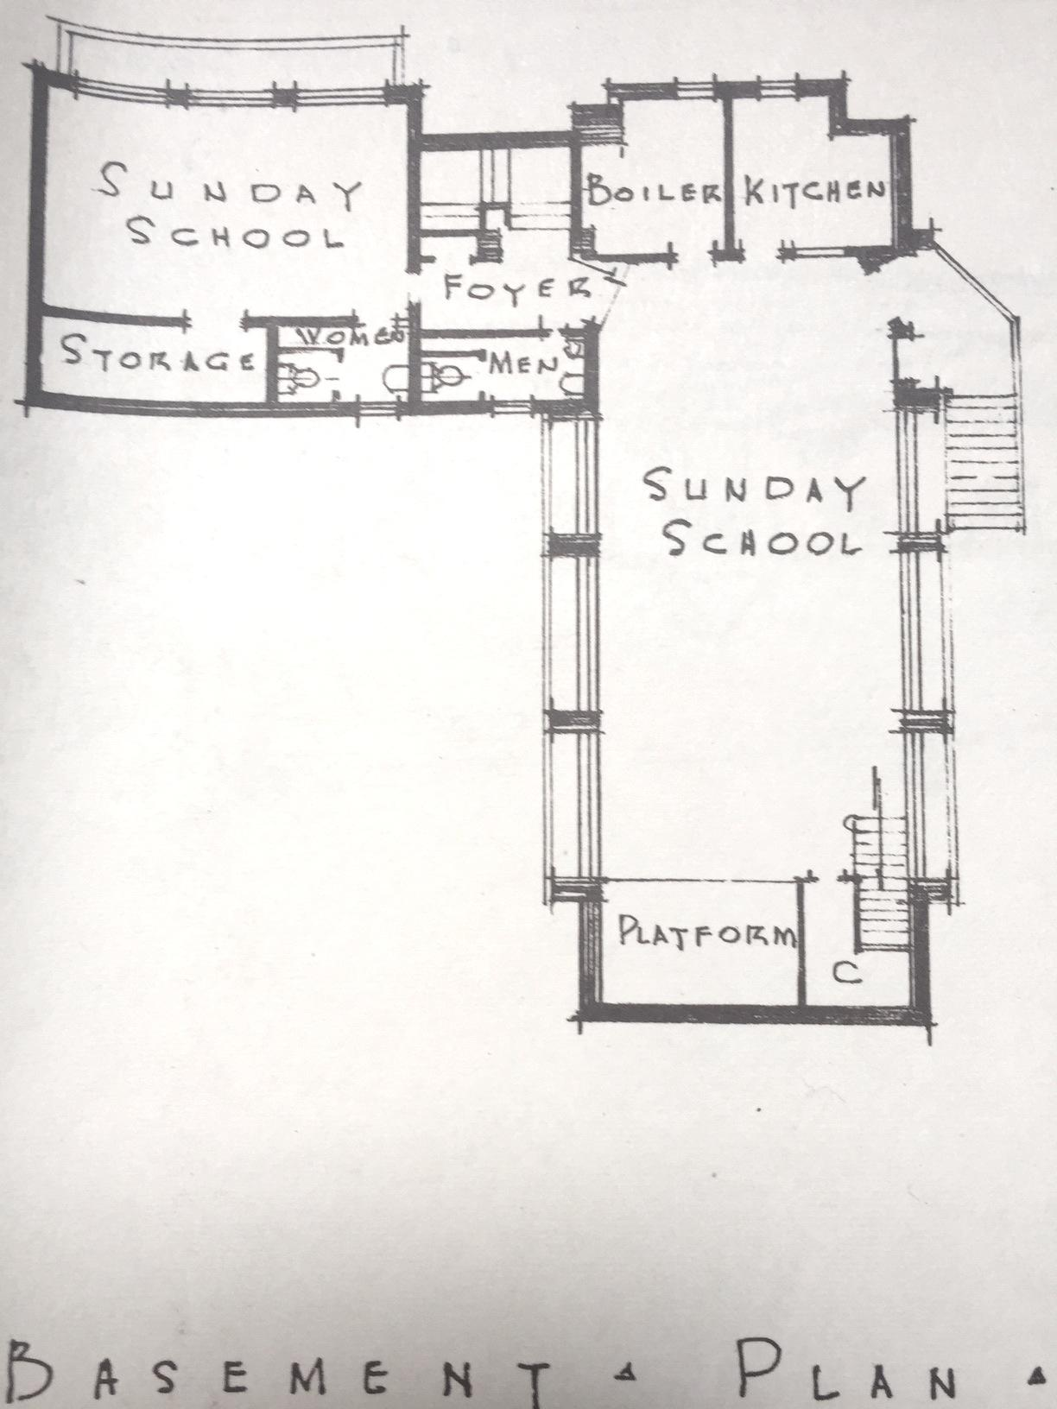

Slide 26
Land Acquisition
1957
House purchased to increase space for Sunday School. Redeemer Community Life
1950’s - 2015 Women of Redeemer formed and met regularly. They had Bible studies and supported the work and life of the community and congregation with various projects and fundraising.

Slide 27
Portland, OR 1960’s

Slide 28
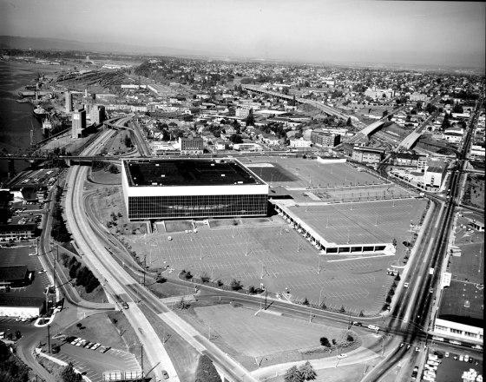
November 3, 1960
Construction of Memorial Coliseum is completed.

Slide 29
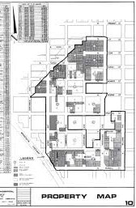
1961-1969 The Emanuel Hospital Urban Renewal Zone of 55.3 acres is formed.
One hundred and one properties were privately purchased by Emanuel Hospital and used as the local match for urban renewal funding.
Non of the owners received relocation benefits.

Slide 30
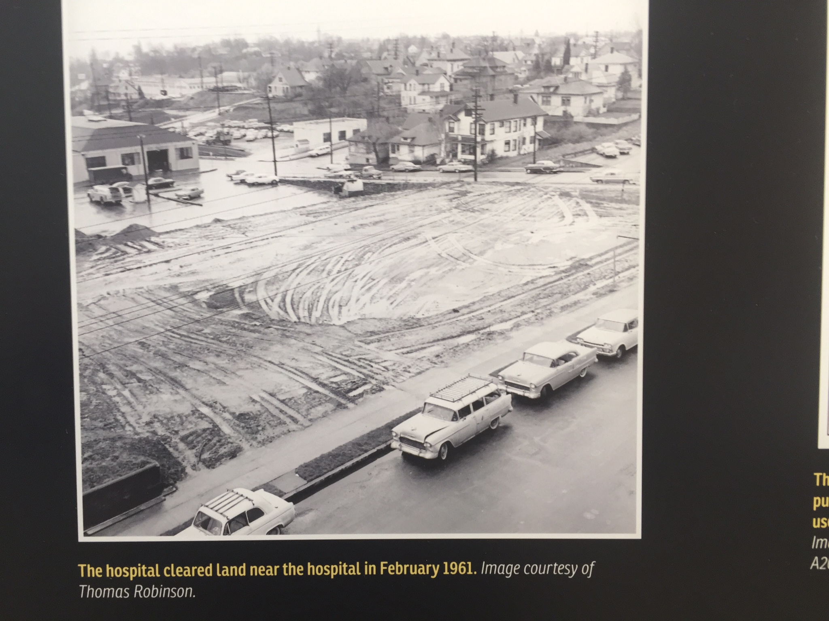
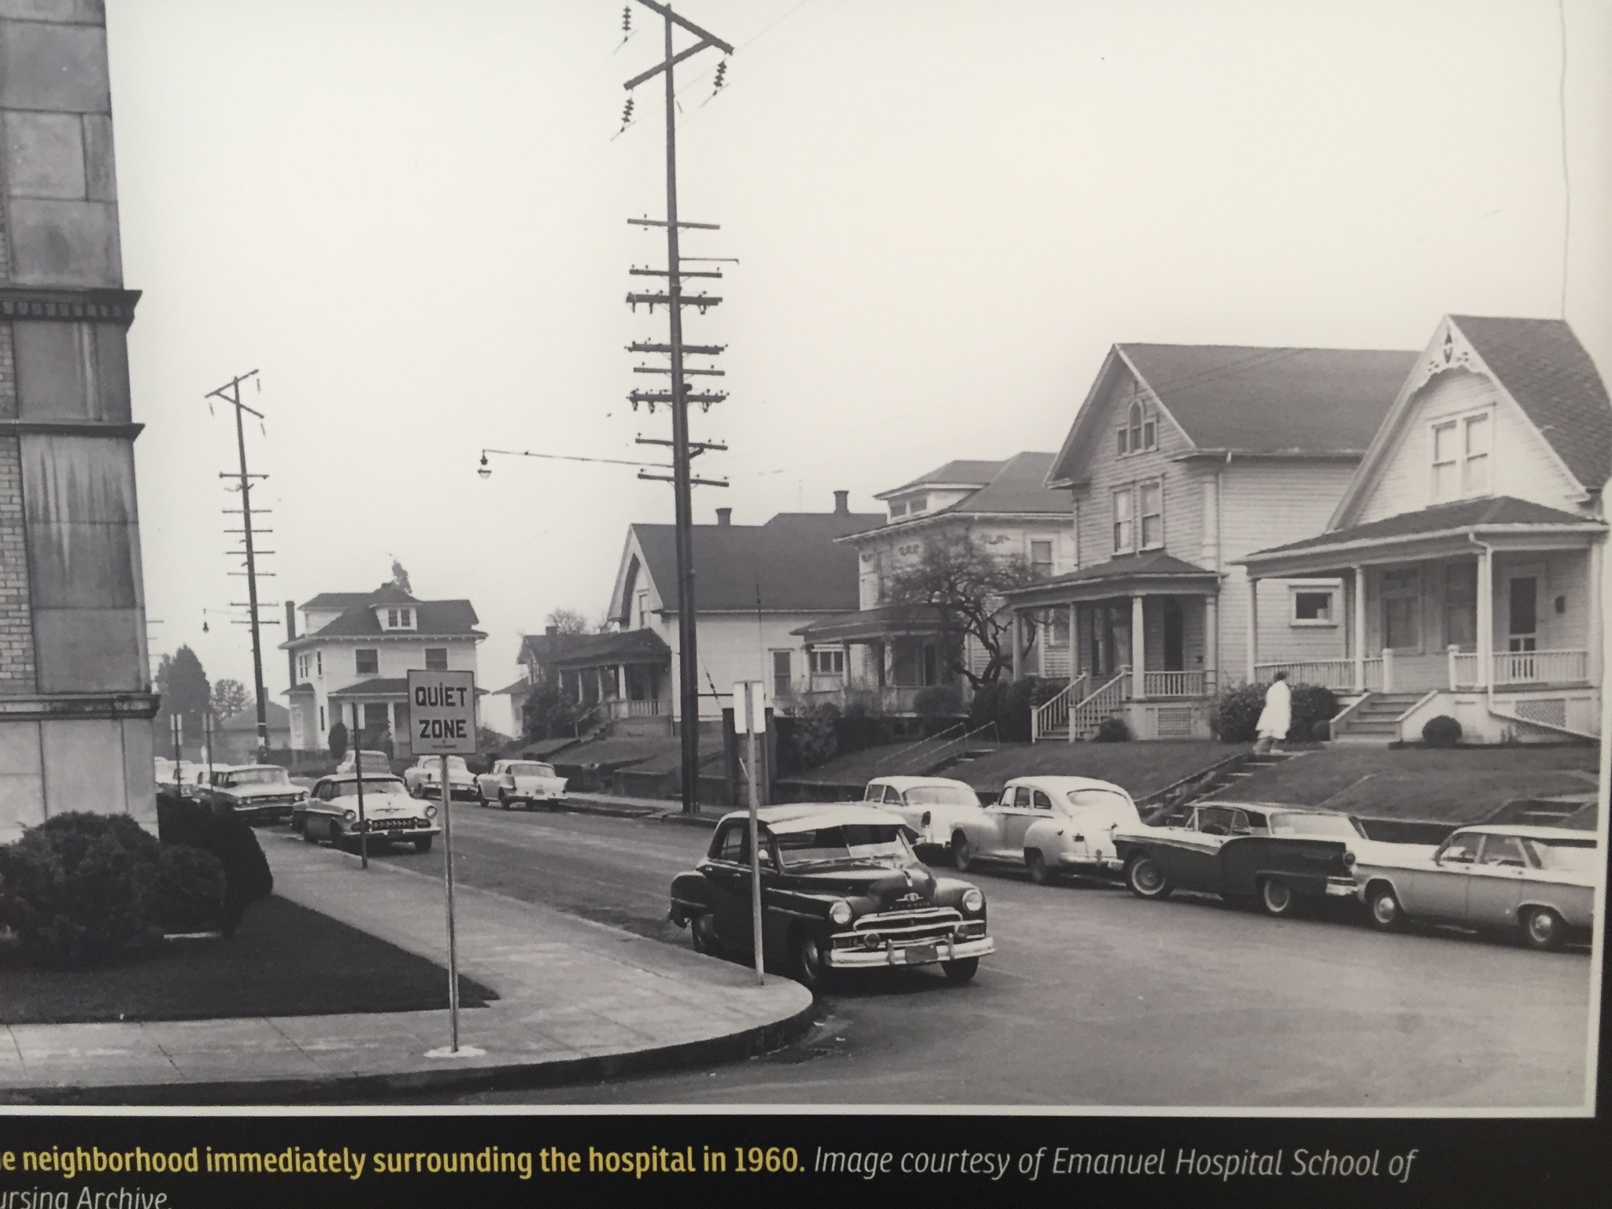
Land Acquisition 1960 and 1961
Neighborhood surrounding Emanuel Hospital

Slide 31
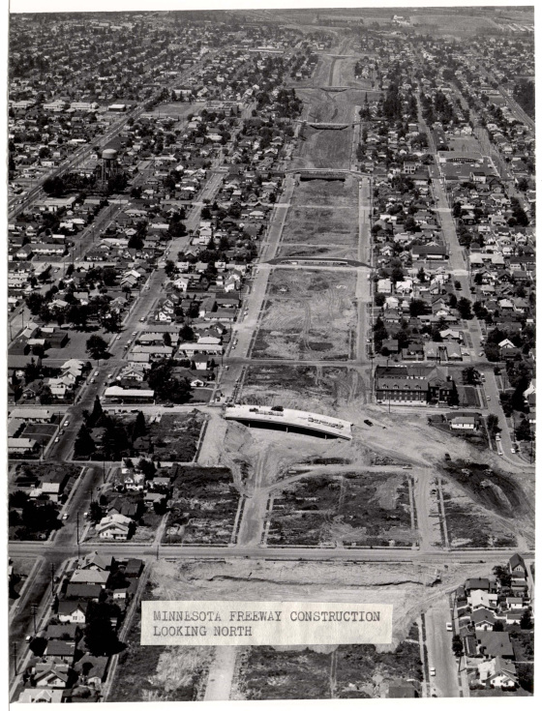
Land Acquisition
1960’s
Several hundred housing units were demolished in the Eliot neighborhood to make way for Interstate 5 and Highway 99, both running north/south through Albina.
Intersate-5 Freeway Construction 1962

Slide 32
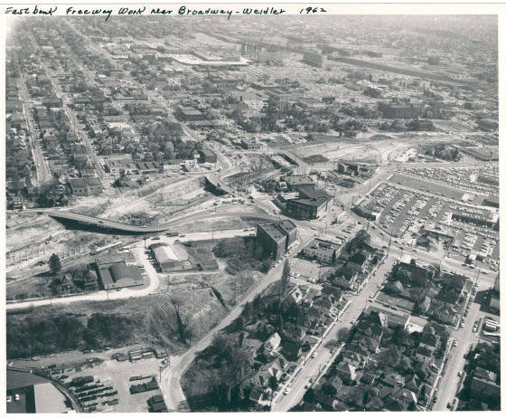
Eastbank Freeway near Broadway-Weidler 1962

Slide 33
Land Acquisition
1960’s
Albina-area residences, housing stock had seriously deteriorated by the 1960s.
Black homeowners complain about lack of access to capital for home purchase and rehabilitation.
Prospective buyers could not buy and sellers could not sell, except if they lent the money themselves.
Many in Albina, Black and White, purchased their homes “on contractors.

Slide 34
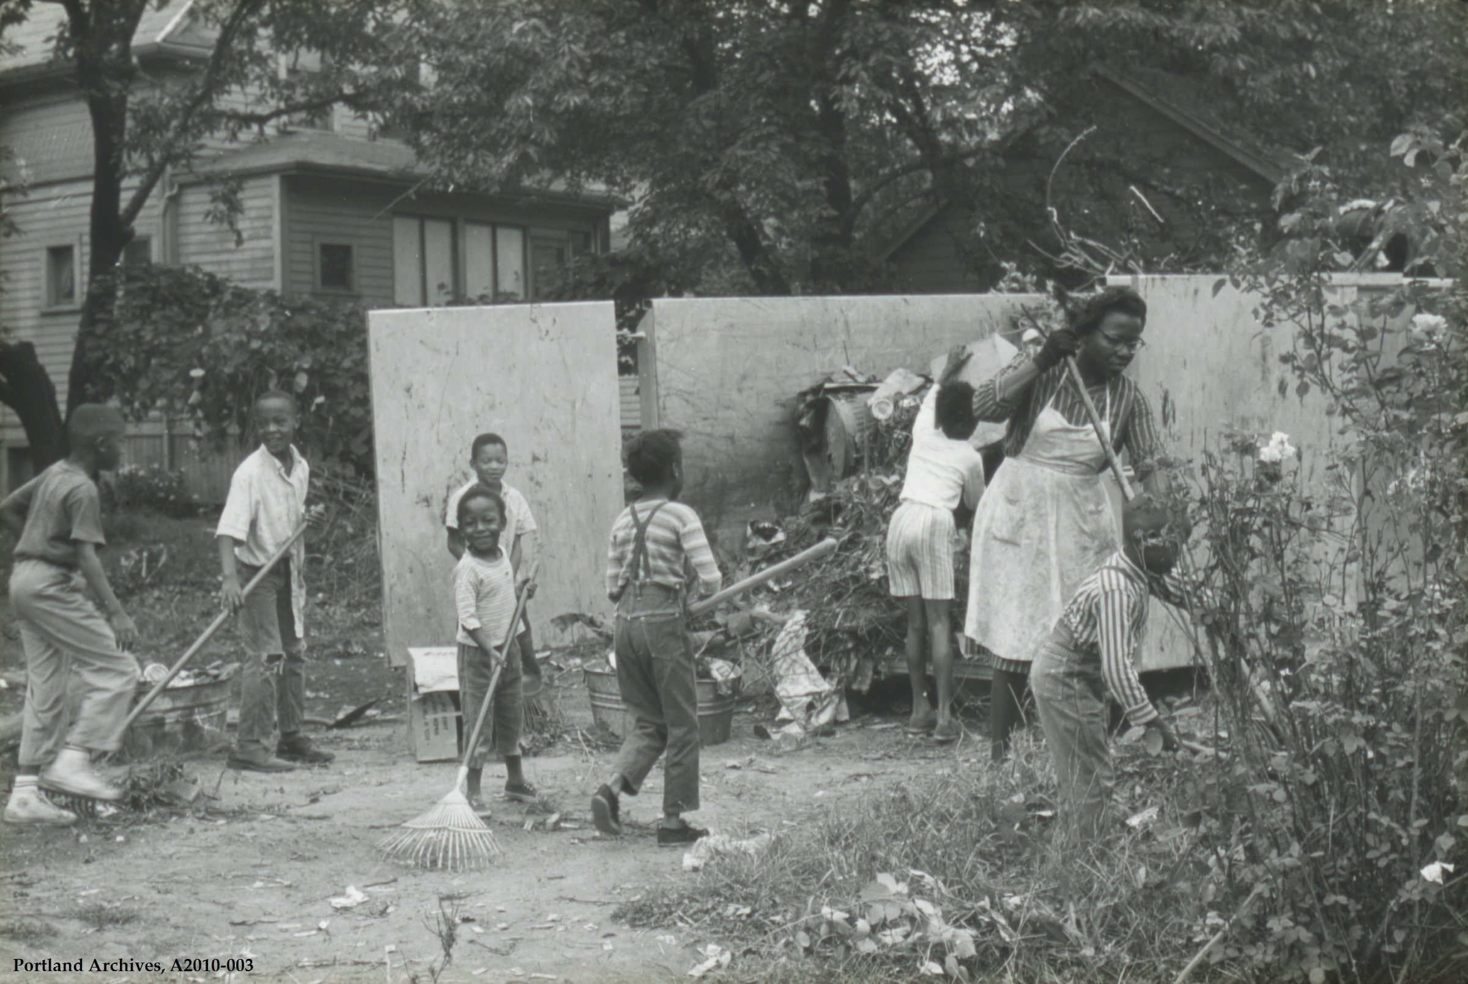
Albina Neighborhood Improvement Program
1961–1973
Albina residents organized, seeking to remedy the problem of aging and declining housing conditions through rehabilitation, not clearance.

Slide 35
Land Acquisition 1969 Blacks with middle wage to working wage income, significantly increased the number of homes owned in Irvington, King, Sabin, and Woodlawn. However, the overall Albina home ownership rate declined from 57 percent to 46 percent.

Slide 36
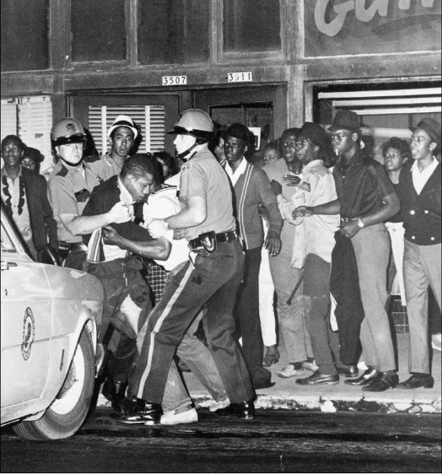
Albina Community Life There was great frustration in the Black community over inadequate education, funding and jobs, especially for youth. 1967 On Sunday, July 30, 1967, a riot. started in Irving Park and moved into Upper Albina. Approximately 300 protestors, primarily African American and some whites, were met by 200 police officers. Helmeted officers rode 4-5 to a car with their rifles and shotguns out of public view. 500 National Guard troops were on call with another 6,000 reservist at home.

Slide 37
Redeemer Lutheran 1960’s

Slide 38
Land Acquisition
1960
Five houses and two extra lots were purchased and the houses razed for ample parking.
Killingsworth St.
1
9
T
H
Ave
2
0
T
H
Ave

Slide 39
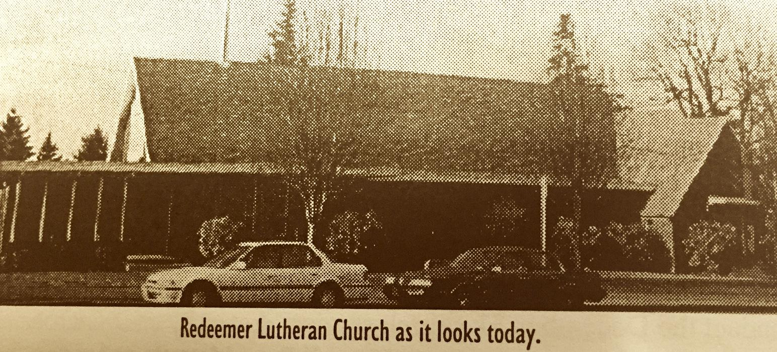
Building Addition
April 25, 1965
Ground-breaking for addition including sanctuary.
November 14, 1965
Dedication. Additional land valued at $30,000. New addition at $155,000.
Only $110,000 was borrowed from Lutheran Mutual Insurance Company. Remaining amount raised by the congregation.

Slide 40
Redeemer Community Life
In 1967 Mrs. W.I. Eck had 200 shares of AT&T stock to start a scholarship fund for the education of youth and adults.
Other churches turned down her offer to manage the fund. Redeemer Lutheran stepped up and oversaw the fund for over 40+ years.
The last scholarship was awarded in the late 2000’s when all the funds were used up.

Slide 41
Portland, OR 1970’s

Slide 42
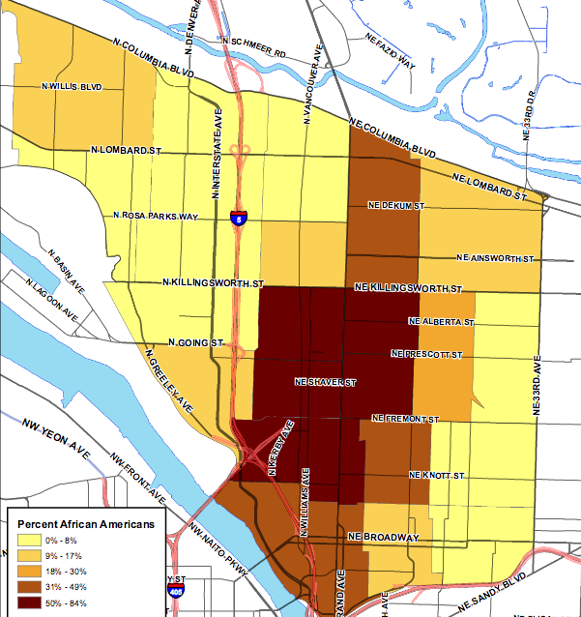
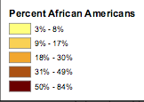
*
1970
Percent African Americans
3% - 8%
9% - 17%
18% - 30%
31% - 49%
50% - 84%

Slide 43
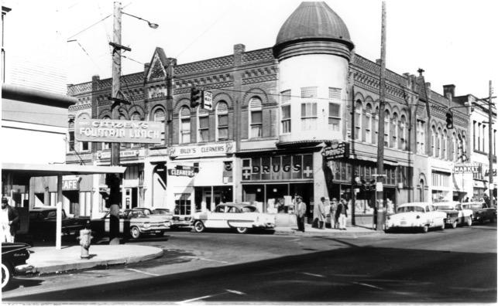
“Main Street in Albina”
During the 50’s Rozell and Bea Gilmore owned Citizen’s Fountain Lunch Café (bottom left). Central Albina – the area around Williams and Russell – became the heart of the community with bustling jazz clubs, salons, record stores and restaurants.

Slide 44
Land Acquisition
1971
The Portland Development Commission (PDC) and city quietly develop plans to site a federally supported veterans’ hospital at the Emanuel Hospital site.
PDC acquired additional land. Residents find out two months before clearance of 76 acres. 74% of those relocated were black.
In total, twenty-two blocks in the Eliot neighborhood were cleared. Nearly 300 homes and businesses in North Portland razed; destroying what was then the heart of the area's African American community.
The Emanuel Hospital expansion was cancelled in 1973 due to lack of federal funding.

Slide 45
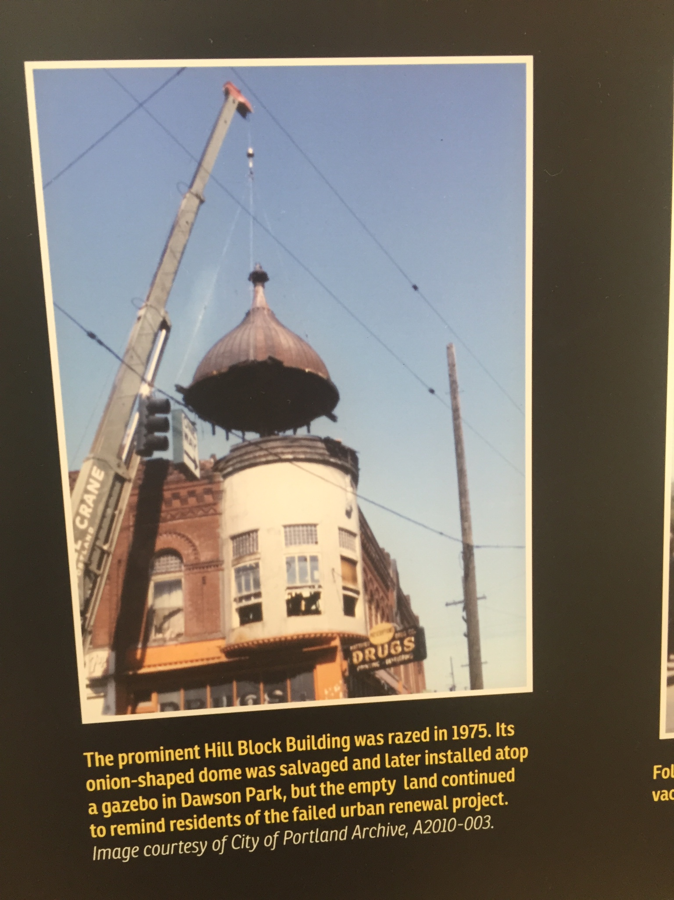
1970’s

Slide 46
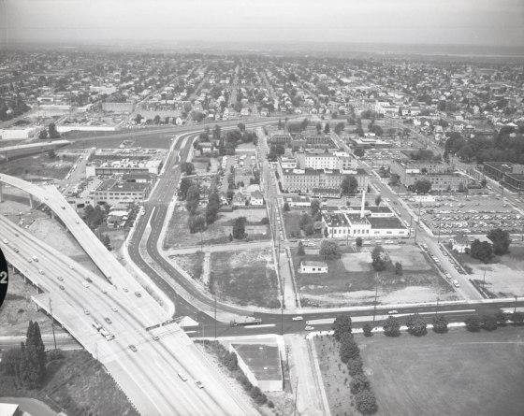
Land Acquisition After the heart of the Black community was demolished, the federal project fell through, and large swaths of land lay vacant decades after the renovation of Emanuel Hospital.

Slide 47
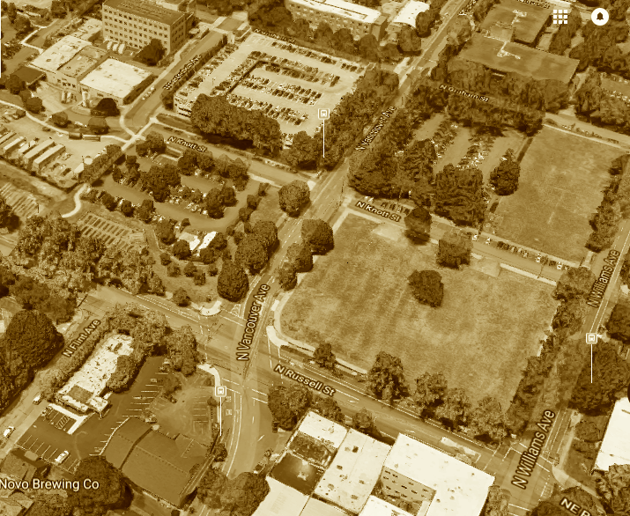
Early 1970’s
1,100 homes and hundreds of businesses in Central Albina were loss due to construction of the I-5 freeway, Memorial Coliseum and Emanuel Hospital Expansion
Neighborhood surrounding Emanuel Hospital today

Slide 48
Redeemer Lutheran 1970’s

Slide 49
Land Acquisition
1970
Land on corner of NE 19th and Killingsworth, known informally as “The Ice Cream Store,” was purchased for $1,200. House was in disrepair and torn down. Area fenced and turned into a playground and/or vegetable garden.
1979
Congregation purchased house on Killingsworth street adjacent to church property with a $12,000 gift from a member. It was rented to a family from congregation.
June, 1979
$110,0000 mortgage burning celebration.

Slide 50
Redeemer Community Life
Lutheran Refugee Immigration Services helped families fleeing from areas experiencing war, persecution and famine. Redeemer sponsored and help families re-settling in America during the late 1970’s and early 80’s.
1978 -1979
Van Tron came from Vietnam. He worked and purchased several service stations in the area. Later he became a LCMS pastor and started ministries in Vietnam.
June 4 1979
With sponsorship of 10 churches and groups, Redeemer becomes the location of Alberta Park Loaves and Fishes

Slide 51
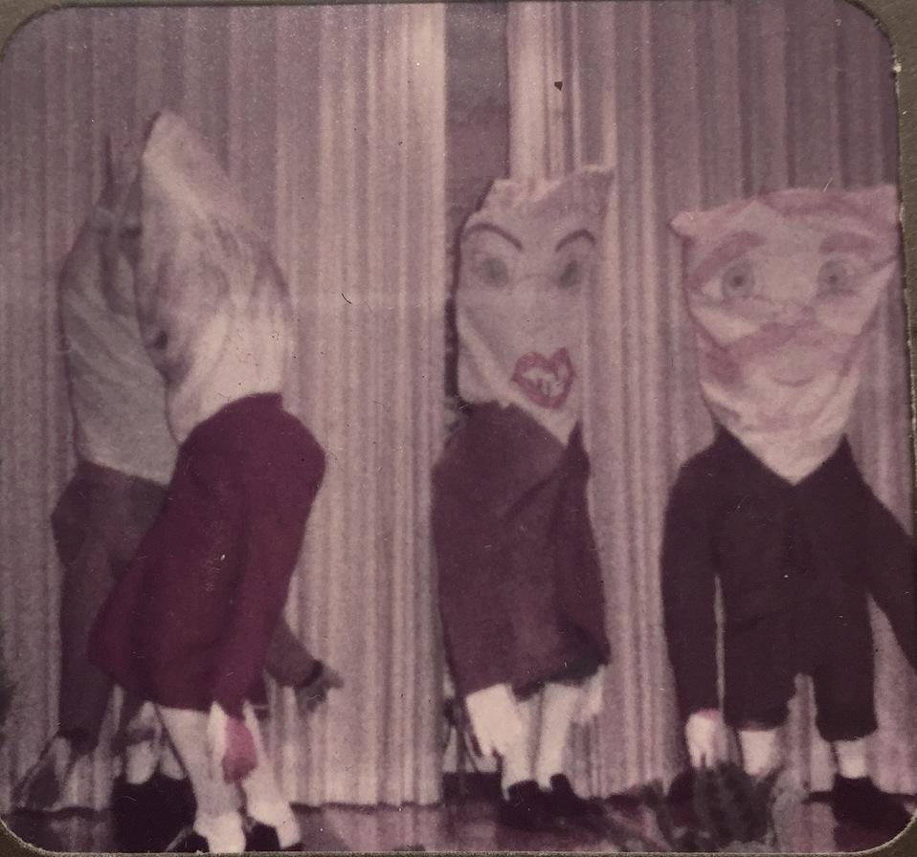
Women of Redeemer had many ways of earning money to help with various projects for the church, charities and other needs as seen in the following skit.
Women of Redeemer skit

Slide 52
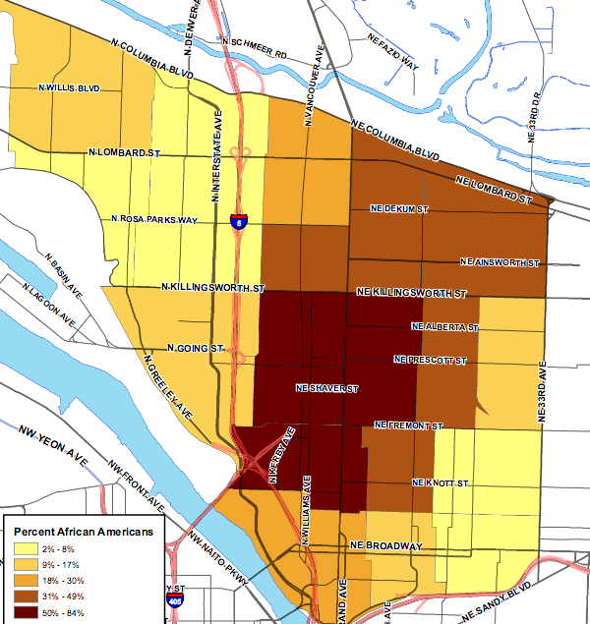
1970
1980
Percent African Americans
3% - 8%
9% - 17%
18% - 30%
31% - 49%
50% - 84%

Slide 53
Portland, OR 1980’s

Slide 54
*
1980
Percent African Americans
3% - 8%
9% - 17%
18% - 30%
31% - 49%
50% - 84%

Slide 55
Inner N-NE Community Life
Economic Investment
Drug dealing became a way for those out of work to make quick money, and abandoned houses provided a place to both use and abuse.
1987
During the summer, competition intensified between the Crips and the Bloods over crack cocaine.

Slide 56
Inner N-NE Community Life
Land Acquisition
The banking industry had left a vacuum in the community when it decided not to lend money on properties below $40,000.
The value of homes dropped to 58 percent of the city’s median.
1987
All the banks and thrifts in Portland made just ten mortgage loans to a four-census tract area constituting the heart of the Albina community.
1988
They made nine loans. This was one-tenth the average number of loans per tract in the metropolitan area (Lane 1990b).

Slide 57
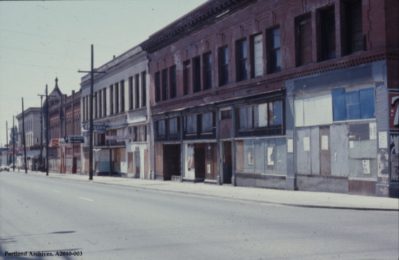

Slide 58
Redeemer Lutheran 1980’s

Slide 59
Land Acquisition
1982
Former pastor, Werner Jessen and wife Ruth, deeded to the congregation additional land located south of church thus expanding parking area and providing two garage bays for storage of equipment.
1986
A member family donated a parcel of land located in Clark County, WA. The land was sold as part of a stewardship campaign. Funds were used to support the general mission of the congregation.

Slide 60
Redeemer Community Life
Jan 13, 1981
Rev. Terry Moe was called to pastor the congregation of
Redeemer Lutheran

Slide 61
Redeemer Community Life
1980’s Lutheran Refugee Immigration Services
Single man from Ethiopia
Family from Laos
Extended Family from Eritrea
Tigrinya language school classes held in building on Saturday mornings. Tigrinya is the majority language spoken in Eritrea. The Eritrean community had meetings in the building until the mid 2000’s.
Redeemer continues to be the location for Alberta Park Loaves and Fishes
Women of Redeemer continue to raise funds and do projects for church and community programs.

Slide 62
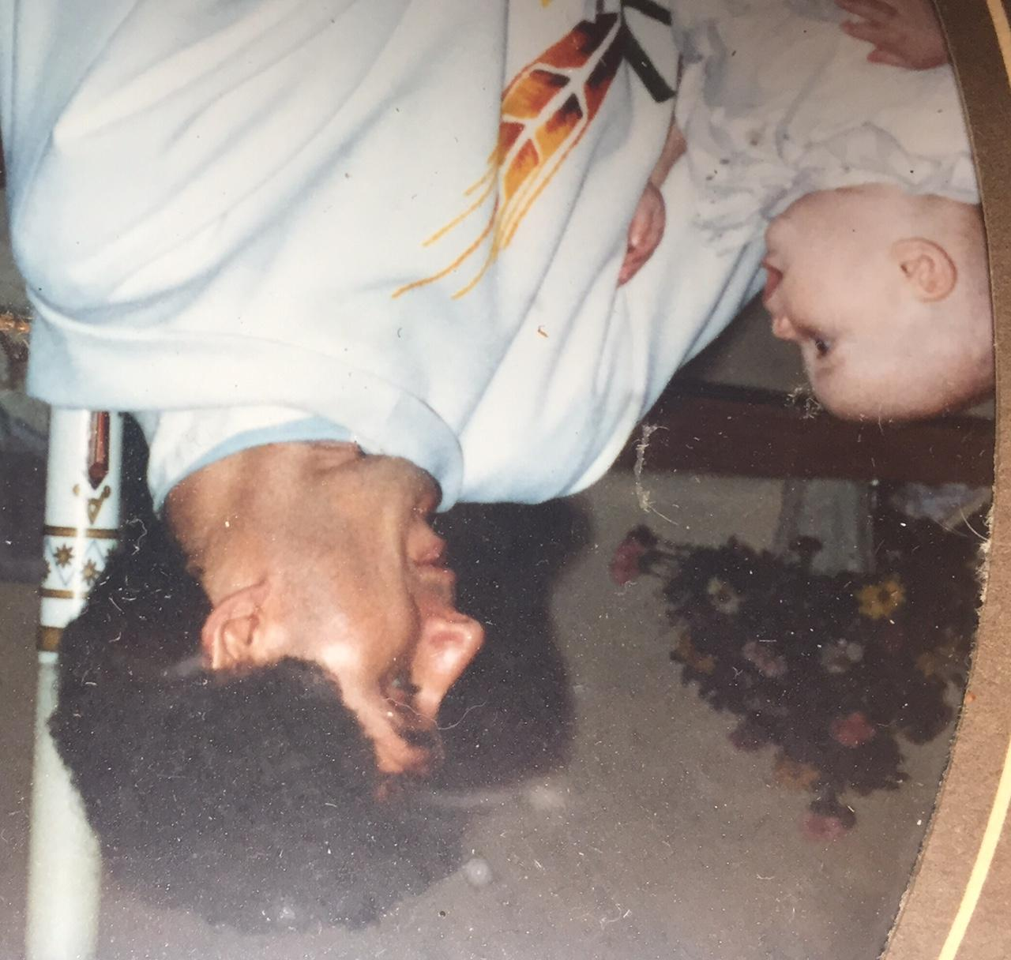
Pastor Terry Moe
19 Baptisms in the late 80’s

Slide 63
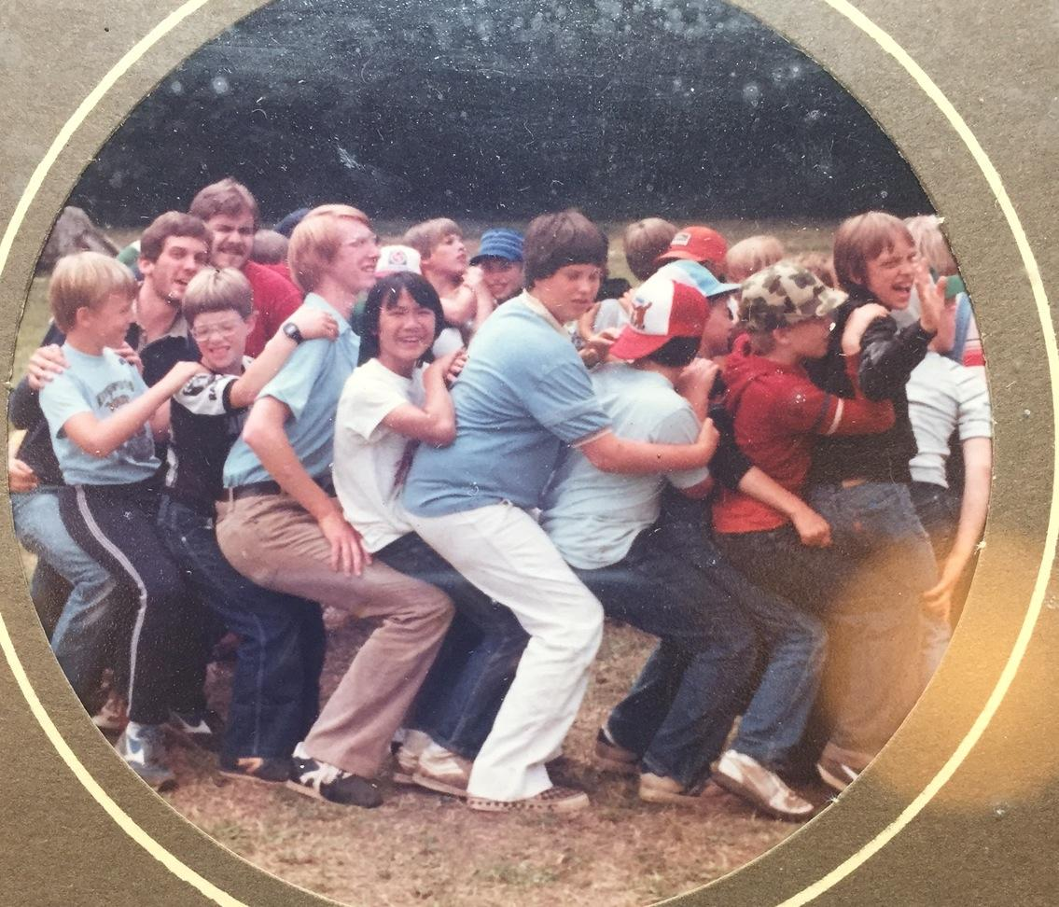
Camp Lutherwood: 1980’S
4th from left: Sisavath, immigrant from Laos and a Redeemer member.

Slide 64
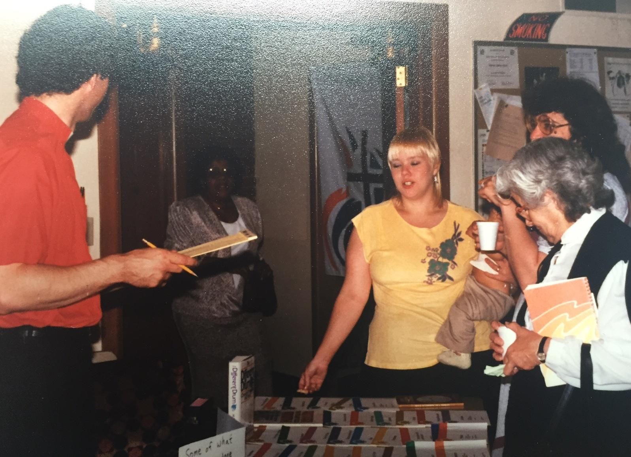
L-R: Pastor Moe, Laura Barber, Trish, unknown, Joan Miller. Joan and Leo Miller were “solid rocks” in the congregation. Joan and Leo eventually moved to Eugene to be with family.

Slide 65
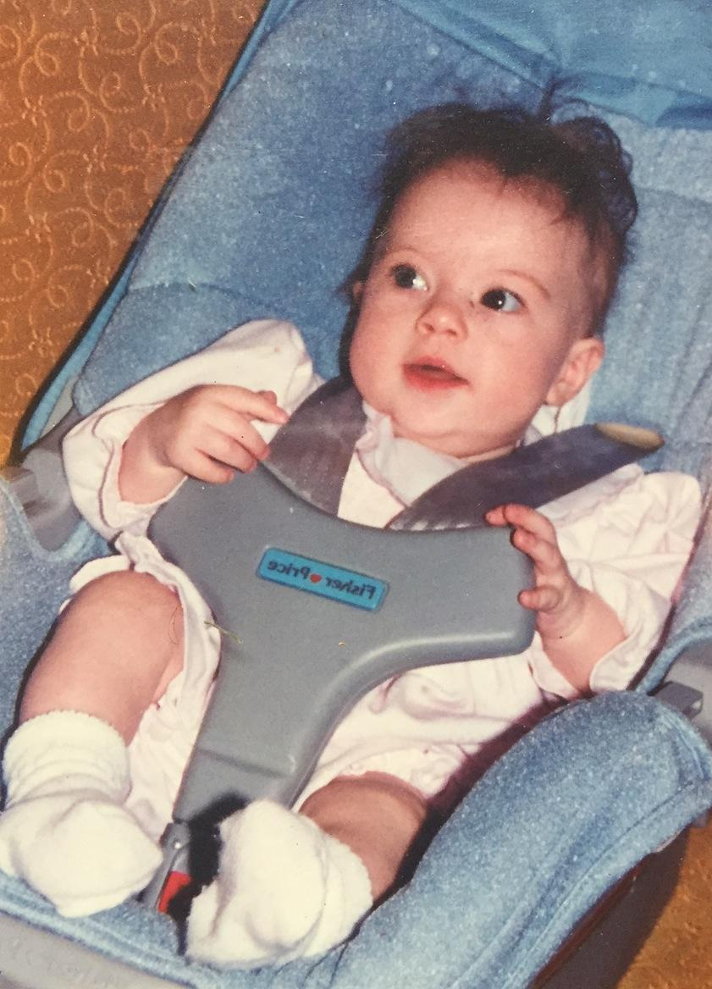
Sam Phelps

Slide 66
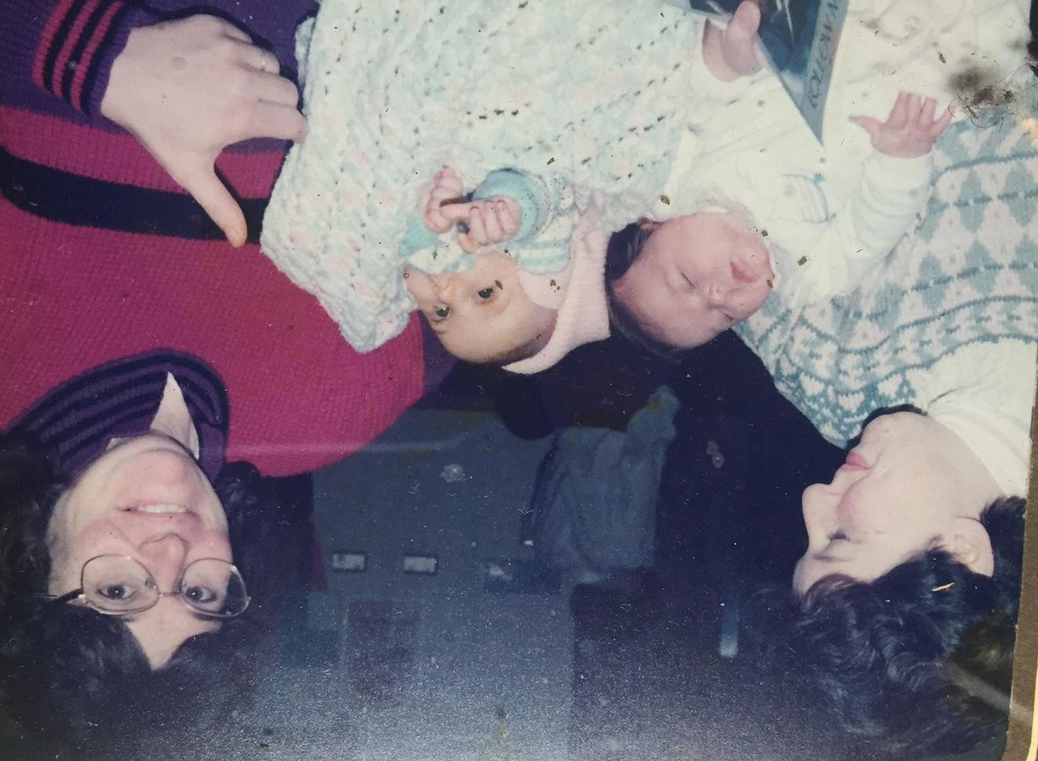
Dory Schutte &
Peggy Pietka with baby Jackie and Dory Rochat-Schutte with baby Marie

Slide 67
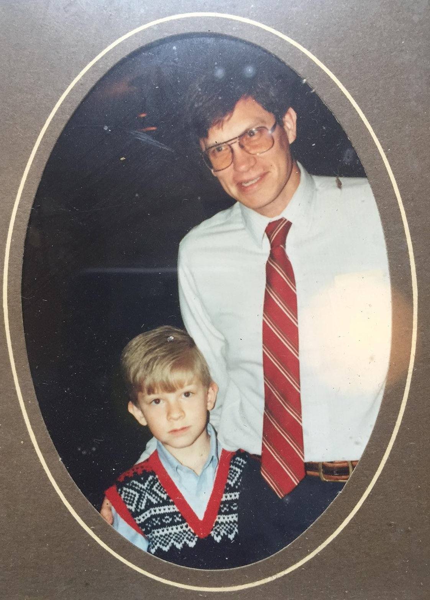
Jim Francis and son, Kevin

Slide 68
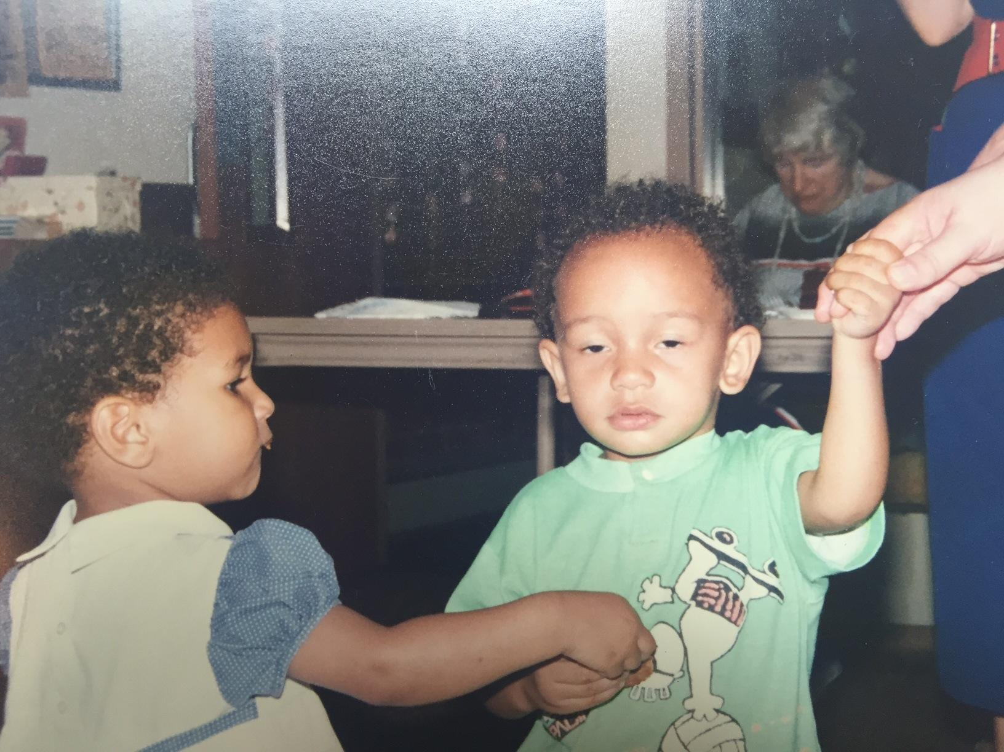
Ivy Flint and unnamed friend

Slide 69
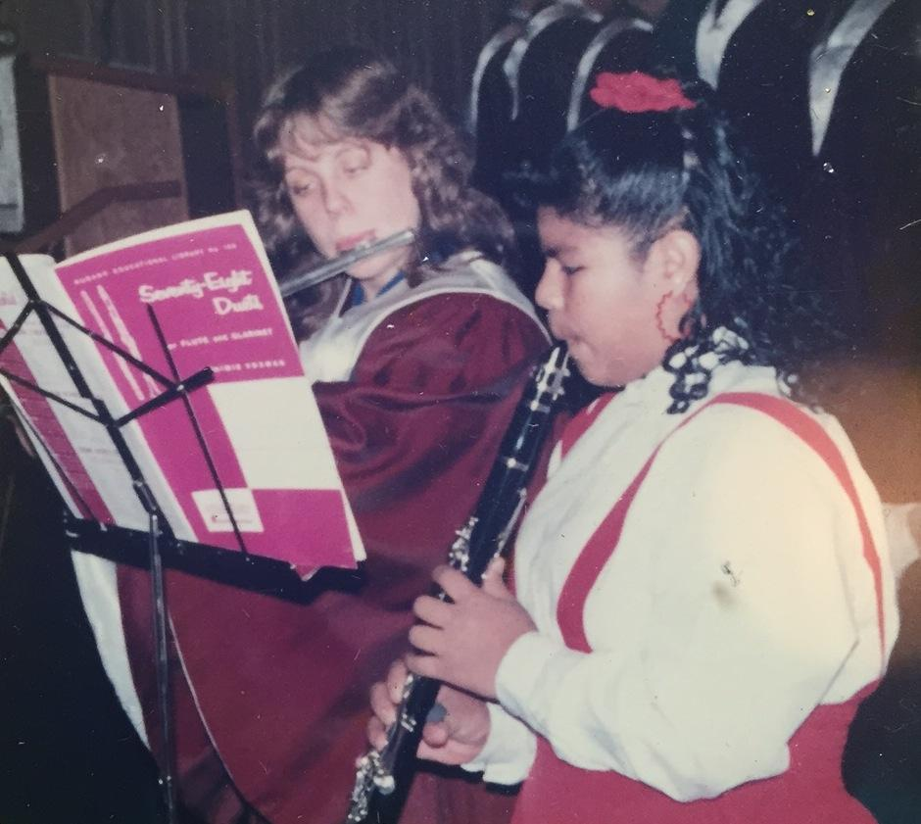
Lois Jordahl and Erika Pehrus

Slide 70
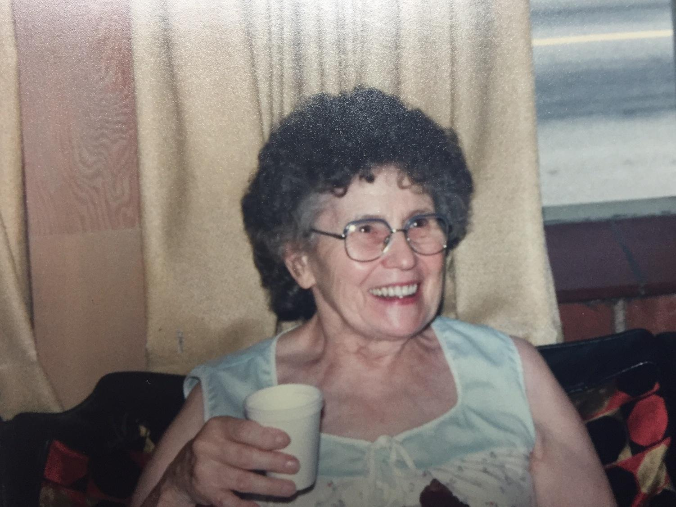
Madeline Jewett

Slide 71
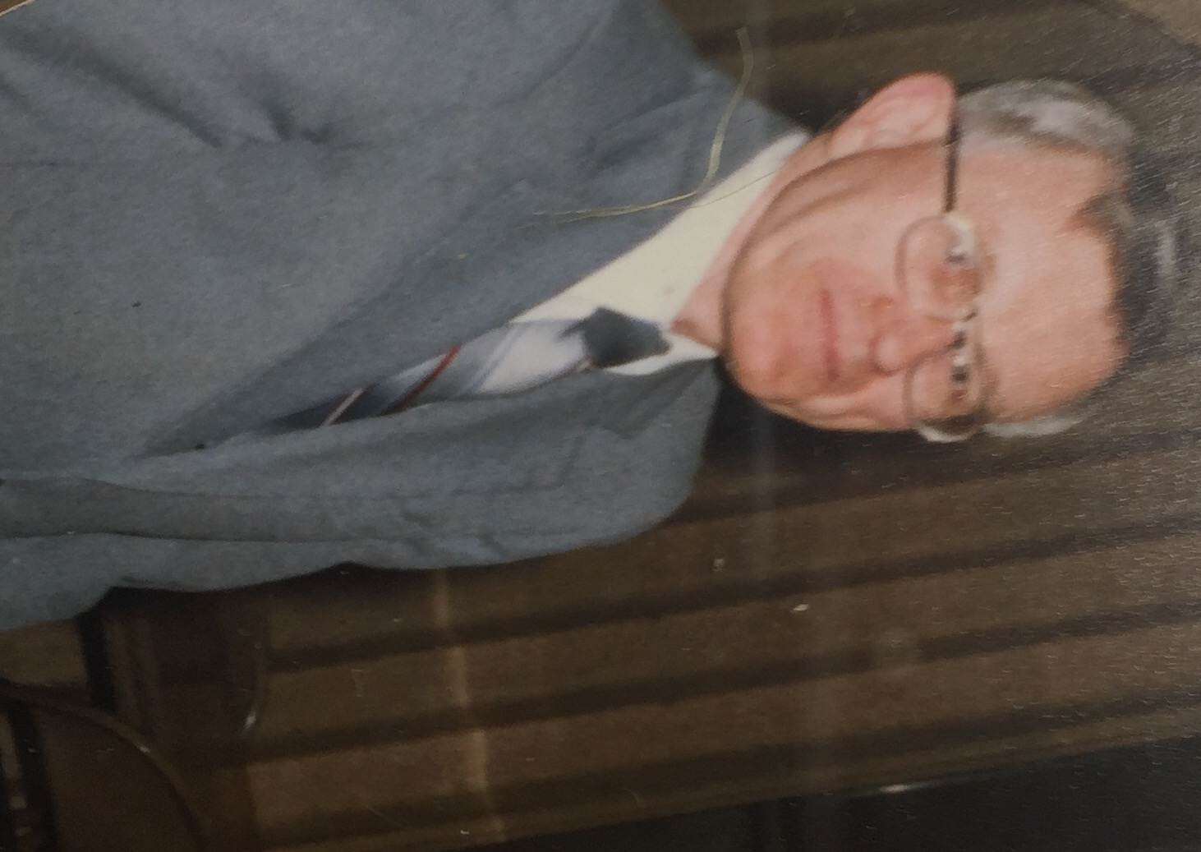
Eric Jordahl

Slide 72
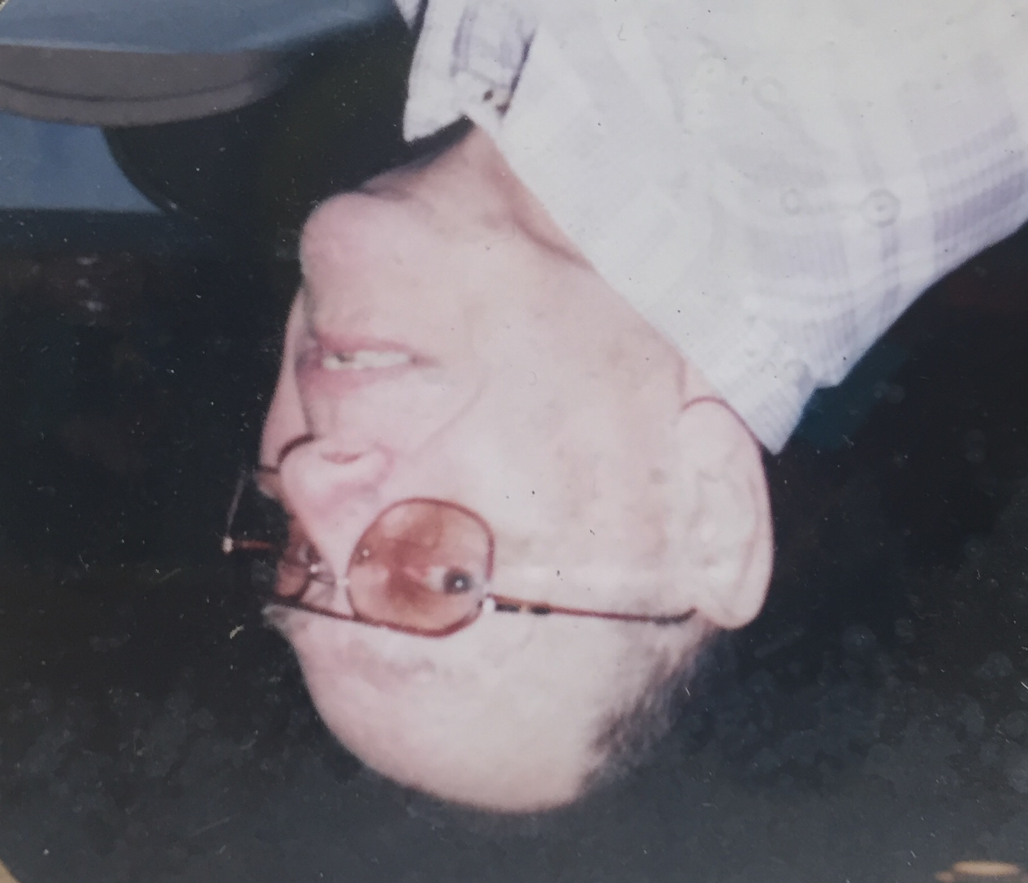
Bob Barner

Slide 73
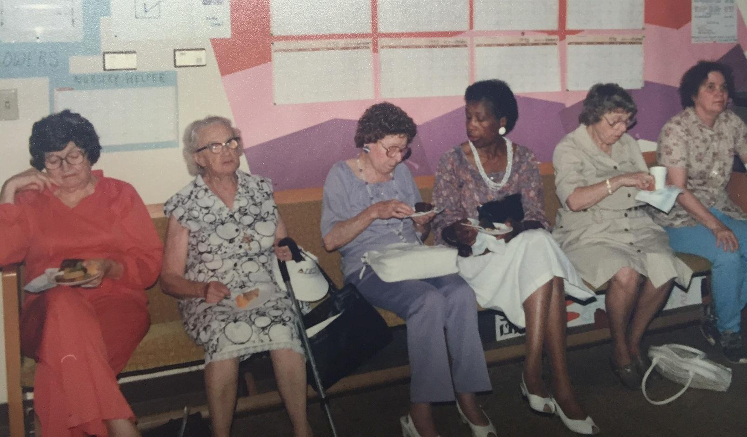
Vivian Richardson (4th from left)
L-R: unnamed, Lydia Sloan, unnamed, Vivian Richardson, unnamed, Priscilla Morgan

Slide 74
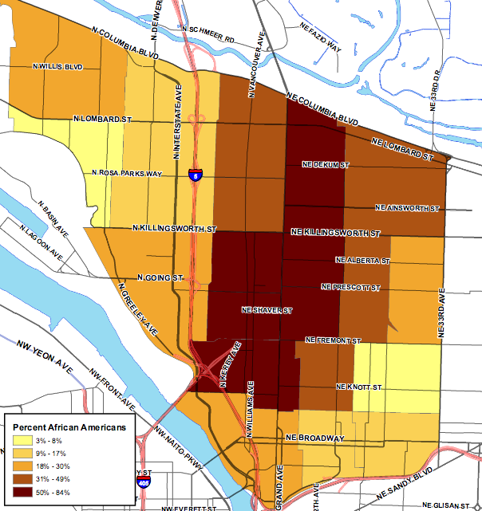
1980
1990
Percent African Americans
3% - 8% 9% - 17%
18% - 30%
31% - 49%
50% - 84%

Slide 75
Redeemer Community Organizing
Mid 1980’s
The Portland Organizing Project – an interracial coalition of communities of faith - is formed in 1985. Redeemer Lutheran joins the coalition in 1987.
They organized for cheaper sewer rates and the survival of a major grocery store in the inner N-NE Portland neighborhood.
Late 1980’s
The coalition launched campaigns to clean up derelict properties and find alternative activities for youth who might be drawn into gangs.
1988
Portland Organizing Project, began legal challenges against the lending practices of local banks, using the newly fortified Community Reinvestment Act.

Slide 76
Redeemer Community Organizing
Mid 1980’s
The Portland Organizing Project – an interracial coalition of communities of faith - is formed in 1985. Redeemer Lutheran joins the coalition in 1987.
They organized for cheaper sewer rates and the survival of a major grocery store in the inner N-NE Portland neighborhood.
Late 1980’s
The coalition launched campaigns to clean up derelict properties and find alternative activities for youth who might be drawn into gangs.
1988
Portland Organizing Project, began legal challenges against the lending practices of local banks, using the newly fortified Community Reinvestment Act.

Slide 77
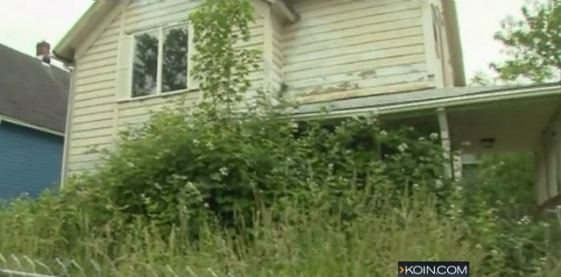
Redeemer Community Organizing
1988
Evidence of bank disinvestment would come to light.
The King and Boise neighborhoods, which comprised 1 percent of the city’s land, contained 26 percent of the city’s abandoned housing units.
The worst neighborhoods were Boise, Eliot, and King, with more than 10 percent of the single-family homes vacant.

Slide 78
Redeemer Community Organizing
By 1989
Absentee landlordism reached its height when only 44 percent of homes in Albina were owner occupied.
The vast majority of the change in housing occupancy among Blacks in Upper Albina (96 percent) and Lower Albina (63 percent) represented Black owners selling homes. Some of this was due to generational change.
White homeowners also left in large numbers, especially in Upper Albina.

Slide 79
Portland, OR 1990’s

Slide 80
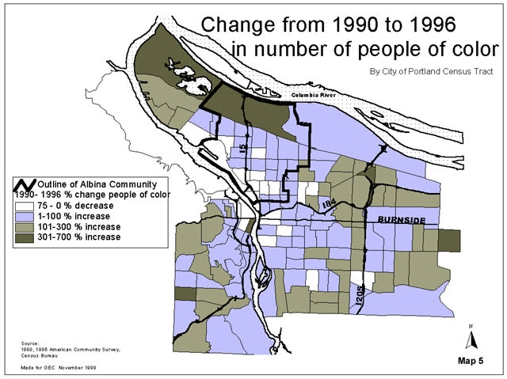
N-Inner NE Community Life
The central city’s core lost 10,000 Black residents in King, Woodlawn Boise-Eliot. They could not afford rising real estate costs. They left Portland or moved to eastern edges of Portland.
White people are now new majority in most census tracts in Portland; single-person households and college graduates.

Slide 81
N-Inner NE Community Life
The City of Portland began using building code enforcement to confront the extreme level of housing abandonment (City of Portland 1988).
It gave more than100 foreclosed homes to the Northeast Community Development Corporation for rehabilitation through the federal Nehemiah grant program.
It stepped up Community Development Block Grant and other spending to support nonprofit housing development.
It shamed the bankers, who had been redlining the community, into supporting the establishment of the Portland Housing Center to help boost home ownership among low-income households.

Slide 82
Redeemer Lutheran 1990’s

Slide 83
*
1990
Percent African Americans
3% - 8%
9% - 17%
18% - 30%
31% - 49%
50% - 84%

Slide 84
Redeemer Community Life
Congregation continues organizing with the Portland Organizing Project.
Women of Redeemer continue to meet, raise funds and do projects for church and community programs.
1990
Vacation Bible School is a collaborative effort with other churches in the area for neighborhood kids. 139 children attended, 18 staff members.
1990
Community children’s choir started called “Hallelujah Kids” choir.

Slide 85
Redeemer Community Life
1990-2008
Redeemer Lutheran accepted for the Horizon Internship Program which included funding for urban, rural and multiethnic communities. Nineteen interns came through the program.
1992
Alberta Park Loaves and Fishes is relocated from Redeemer Lutheran to a new senior center on MLK Jr. Blvd and Killingsworth Ave.

Slide 86
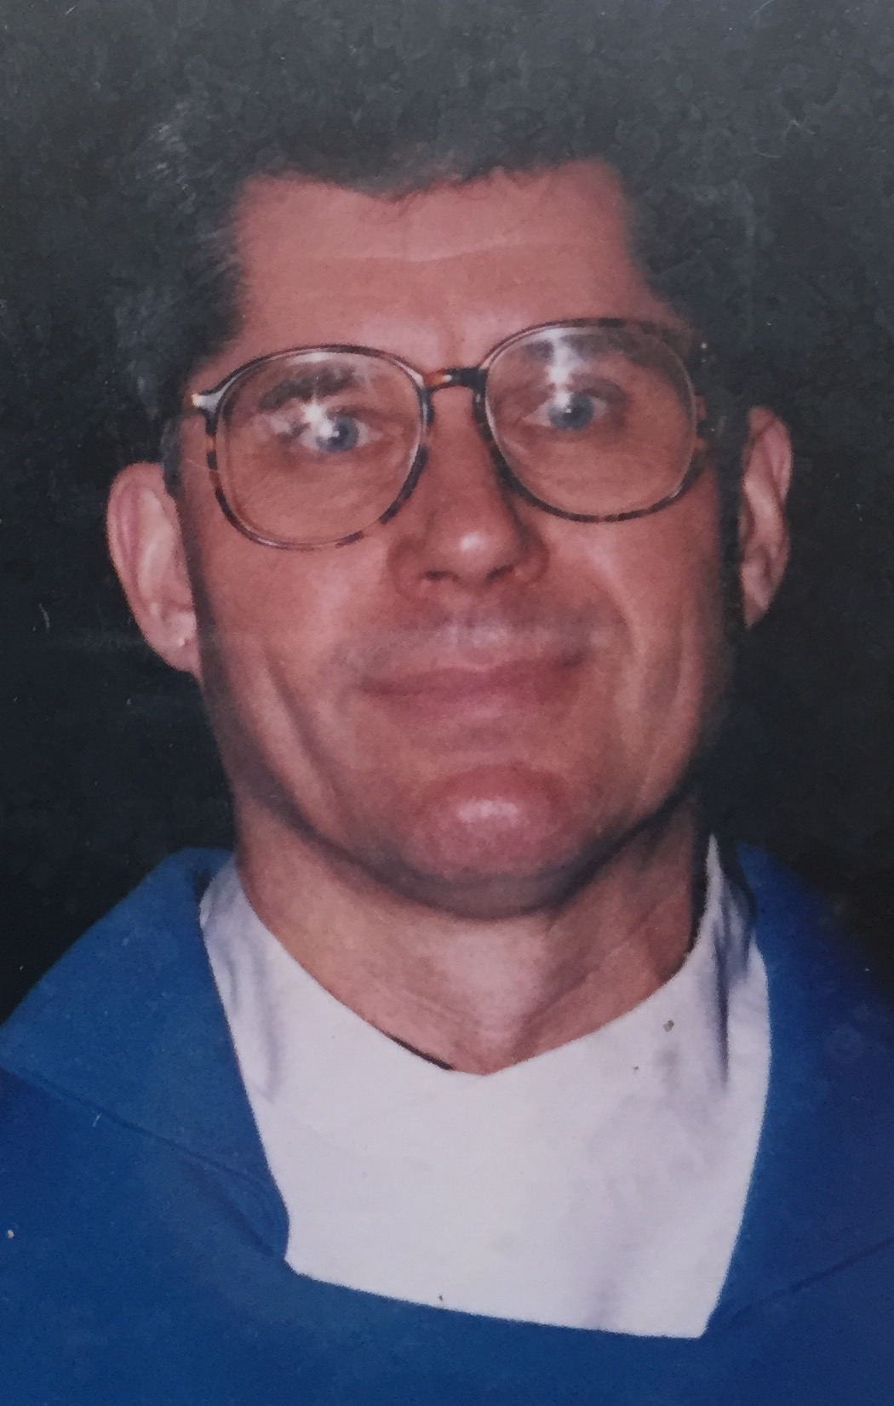
Pastor Terry Moe

Slide 87
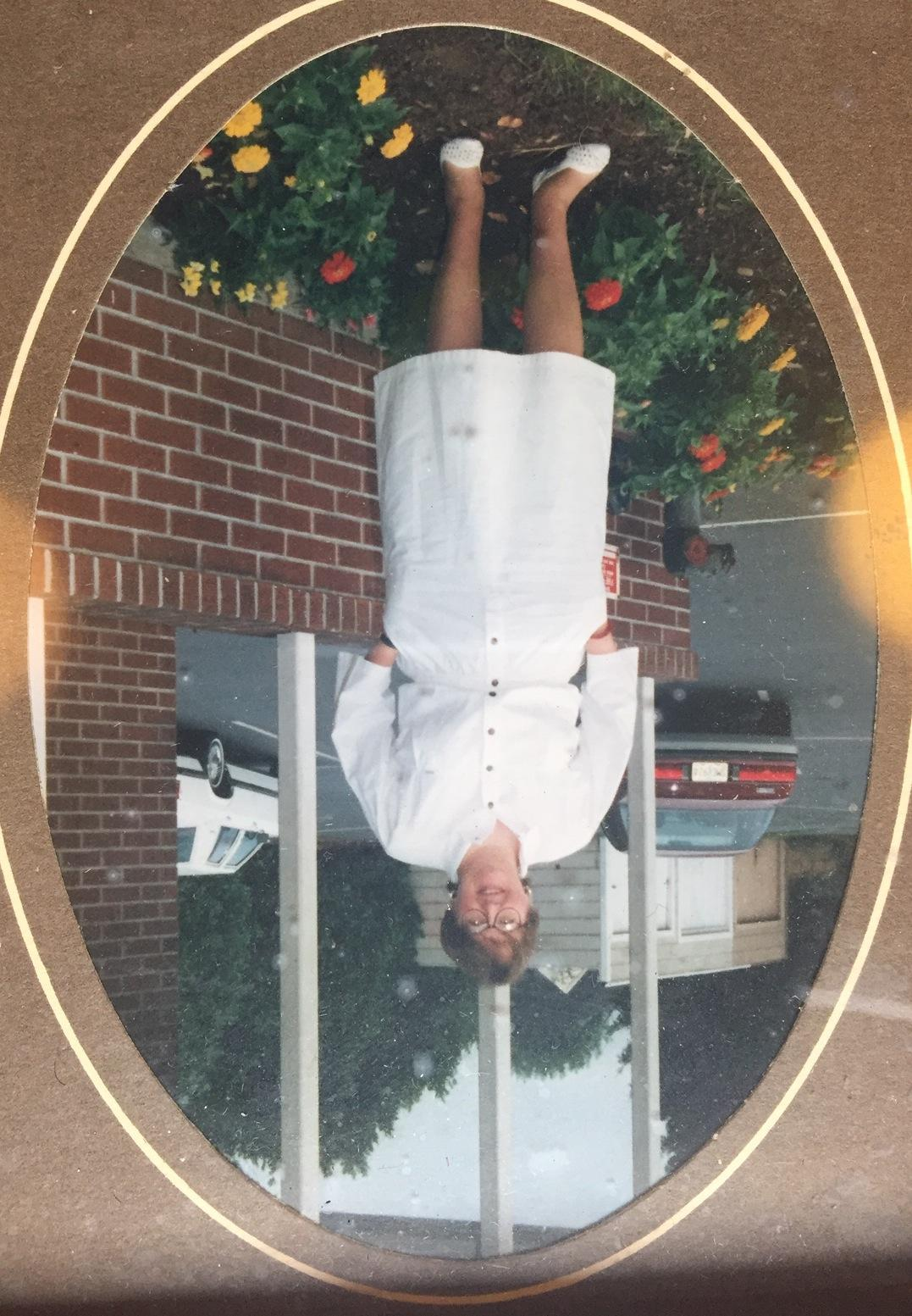
1991-1992 Jaqueline Moren, 2nd intern

Slide 88
Kay Doyle, 3rd intern, and Maurice and Mildred Hanson

Slide 90
Hallelujah Children’s Choir
Hallelujah Children’s Choir, directed by Sheryl Chatman Kimberly Robinson-Green, pianist

Slide 91
Blessing of the stuffed animals

Slide 92
Driggs twins and friend. Their grandmother, Helen Driggs, was a Redeemer member. Children participated through VBS

Slide 93
Rhonda Payne and her class

Slide 94
Danita and Ivy Flint

Slide 95
1995 Intern, Solveig Nielsen-Goodin and and spouse, Peter

Slide 96
1995 Confirmation Class
Front: Danita Flint, Devon Peters, Shawnta Barber Back: Solveig Nielsen-Goodin, intern, RaShawn Barber-Hayes, Devon Peters, Pastor Moe

Slide 97
Ben Webb and daughter, Damaris Webb

Slide 98
Rev. Kelly Chatman & Joan Miller

Slide 99
Martha Kirby & Carolyn Barnett (pianist)
Martha Kirby & Carolyn Barnett

Slide 100
Baptism

Slide 101
Paul and Lois Fox with baby Nat

Slide 102
1990
2000
Percent African Americans
3% - 8% 9% - 17%
18% - 30%
31% - 49%
50% - 84%

Slide 103
Redeemer Lutheran 2000’s

Slide 104
*
2000
Percent African Americans
3% - 8%
9% - 17%
18% - 30%
31% - 49%
50% - 84%

Slide 105
Land Acquisition
2005
Redeemer develops plans to sell 6 lots of its property
(about 20,000 sq ft) in order to fund significant outreach and “To do something good for the community,” presumably affordable housing.
2006
Redeemer considered a full price offer ($660,000) from Home Ownership One Street at a Time (HOST) to build 18-20 units of affordable housing (60-80% AMI). As Redeemer went through a required Conditional Use Permit process with the city, the 2007 housing crisis happened and consequently, funding disappeared
2010
Two land parcels were sold to a market rate developer allowing Redeemer to go forward with significant outreach. Eventually Leaven Community was founded but the affordable housing dream was lost.
early-mid 2000’s
Land and Buildings

Slide 106
Redeemer Community Life
2003 - 2010
Enterbeing emerges and in 2004, moves to a space on Alberta street as a satellite ministry of Redeemer on Alberta street. The space host an art gallery, classroom space and Wednesday Gatherings.
By 2010 the cost of space on Alberta is too expensive. Enterbeing is closed.
2010
Wednesday night gatherings are held at Redeemer for a season.
2010 forward
Congregation is involved in community organizing with Metropolitan Alliance for the Common Good.
early - mid 2000’s

Slide 107
Redeemer Community Life
Inter-congregational Vacation Bible School ceases as neighborhood changes
“Hallelujah Kids” choir ceases.
Women of Redeemer continue to meet, raise funds and do projects for church and community programs.
early - mid 2000’s

Slide 108
2000
2010
Percent African Americans
3% - 8% 9% - 17%
18% - 30%
31% - 49%
50% - 84%

Slide 109
Redeemer Lutheran 2010’s

Slide 110
2010
Percent African Americans
3% - 8%
9% - 17%
18% - 30%
31% - 49%
50% - 84%

Slide 111
Redeemer Lutheran Community
2010
Leaven Project is formed. Melissa Reed is hired as the mission development pastor-organizer and Wendy Hall (Curtis) is hired as the community organizer. The community spends the next 3 years discerning who and how they will be in the changing neighborhood.
2013
The congregation of Redeemer Lutheran has it closing service. Salt and Light Lutheran has its opening service. Leaven Community is founded.
2015 The Women of Redeemer have their final drive for school supplies and cease to meet. The core group of women are aging.
2010 - present

Slide 112
Leaven Community including Salt & Light Lutheran
2014 – September 2019
Leaven Community receives it 501(c)3 non-profit status. Wendy Hall steps down from her position and LaVeta Gilmore Jones is hired as the Organizer-Co Director alongside Melissa Reed, (Pastor-Organizer/Co-Director).
October 2019 – March 2020
Melissa accepts position as a Bishops Associate in the ELCA Oregon Synod. She continues her organizing work with the Leaven Community Land and Housing Coalition. LaVeta continues as Co-Director/Organizer with Leaven Community/Salt & Light Lutheran.
The community rises to the transition and begins preparing for a Listening Season, when, in the second week of March, 2020, a world-wide pandemic brings everything and everyone to a halt.
COVID-19
2010 - present
Land and Buildings

Slide 113
Cycle of Gentrification
1. New housing construction and first cycle of use: After new housing ages, owners move elsewhere: (blockbusting, sometimes to avoid the cost of repair, and the neighborhood has more renters than owners.)
2. Absentee landlords may choose to profit off of the rent and decide not to make repairs. Depending on the market, it may be economically rational to under-maintain the property, to profit off of the rent and decide not to make repairs.
3. Blockbusting: Involves a process of racial succession, or rapid population turnover; the process by which realtors use the fear of racial turnover and property value decline to induce homeowners to sell at below-market prices. Then the realtor sells the property at inflated prices to Black (or other) home buyers.

Slide 114
4. Redlining: The fourth stage is when banks redline the neighborhood; this reduces owner occupancy and often prevents absentee landlords from selling a property they no longer want to keep. At this point, home ownership rates decline, and the downward trajectory of dilapidation continues until the final stage
1. Legalized Compulsions: Use the powers of government to control the movements of minorities such as condemnation powers, urban renewal, and slum clearance
2. Economic compulsions such as refusal to make mortgage loans, Realtors’ codes of ethics, and restrictive covenants
3. Social Controls such as segregation in clubs, schools, and public facilities
4. Physical compulsion through bombs, arson, threats, mobs

Slide 115
1970
1980
1990
2000
2010
Percent African Americans
3% - 8% 9% - 17%
18% - 30%
31% - 49%
50% - 84%

